Slide 1
CMPU-145: Foundations of Computer Science Spring, 2019
6: A few more things on Probability

Slide 2
Conditional Probability III
Notation: We can write that probability as p(A | B). Terminology:
Let S be our sample space: all rolls of two dice
Let A be the event that at least one of the dice shows a 3
Let B be the event that the sum of the dice is 5
Consider the conditional probability of A given B
Calculation: p(A | B) = p(A ∩ B) / p(B)
p(B) = 4/36 (4 different ways to roll 5)
(1,4) (4,1) (2,3) (3,2)
p(A ∩ B) = 2/36 (2 different ways to roll 5 when one die is 3)
(2,3) (3,2)
p(A | B) = (2/36) / (4/36) = 2/4 = 0.5

Slide 3
From Last Week
Woot.com RC sells refurbished computers. 5% of the computers they sell are defective (real web site, fake stat!)
A customer just bought 3 computers from them.
Assume:
the 3 computers are a random sample, and
Each computer’s performance, including any defects, is independent of each other,
What is the probability . . .
that all 3 computers are defective?
that none of the computers are defective?
that at least one of the computers is defective?

Slide 4
Updated Example
What is the probability of 3 independent events (A,B,C) s.t.
all 3 computers are defective?
= p(A)*p(B)*p(C) = .05*.05*.05 = .000125
none of the computers are defective?
= p(!A)*p(!B)*p(!C) = .95*.95*.95 = 0.857
at least one of the computers is defective? i.e. 1 or 2 or 3 are defective
How should we think about this problem?

Slide 5
Slight Digression: Flipping a coin (again)
If we toss a coin three times what is the probability of getting exactly 2 tails?
Sample space: {H,T}³ i.e. tuples of length 3
{HHH, HHT, HTH, HTT, THH, THT, TTH, TTT}
Distribution: Uniform

Slide 6
Slight Digression: Flipping a coin (again)
Let’s consider the sample space when flipping a coin 2X and 3X
{H,T}² i.e. tuples of length 2
{H,T}³ i.e. tuples of length 3

Slide 7
Flipping a coin 2 times
Let’s consider the sample space when flipping a coin 2X
{H,T}² i.e. tuples of length 2.
Probability of getting any one tuple is ¼. All probabilities added together == 1.
One can count 3 ways to get at least one H.. . P(AL1H) = 3/4.
TUPLES | Prob. Calc. of … | Getting this tuple
(H,H) | ½ * ½ | 1/4
(H,T) | ½ * ½ | 1/4
(T,H) | ½ * ½ | 1/4
(T,T) | ½ * ½ | 1/4
i.e. one way of getting 2 Heads & two ways of getting exactly 1 Head out of 4 distinct possibilities.

Slide 8
Flipping a coin 3 times
Let’s consider the sample space when flipping a coin 3X
{H,T}³ i.e. tuples of length 3
Probability of getting any one tuple is 1/8. All probabilities added together == 1.
One can count 7 ways to get at least one H.. . P(AL1H) = 7/8.
TUPLES | Prob. Calc. of … | Getting this tuple
(H,H,H) | ½ * ½ * ½ | 1/8
(H,H,T) | ½ * ½ * ½ | 1/8
(H,T,H) | ½ * ½ * ½ | 1/8
(T,H,H) | ½ * ½ * ½ | 1/8
(H,T,T) | ½ * ½ * ½ | 1/8
(T,H,T) | ½ * ½ * ½ | 1/8
(T,T,H) | ½ * ½ * ½ | 1/8
(T,T,T) | ½ * ½ * ½ | 1/8
(3-choose-2)
(3-choose-1)
i.e. seven ways of getting at least 1 Heads: 1 way: 3 heads + (3-choose-1) + (3-choose-2)

Slide 9
Let’s look at both tables (side-by-side)
Can you see the similarities?
TUPLES | Prob. Calc. of … | Getting this tuple
(H,H,H) | ½ * ½ * ½ | 1/8
(H,H,T) | ½ * ½ * ½ | 1/8
(H,T,H) | ½ * ½ * ½ | 1/8
(T,H,H) | ½ * ½ * ½ | 1/8
(H,T,T) | ½ * ½ * ½ | 1/8
(T,H,T) | ½ * ½ * ½ | 1/8
(T,T,H) | ½ * ½ * ½ | 1/8
(T,T,T) | ½ * ½ * ½ | 1/8
TUPLES | Prob. Calc. of … | Getting this tuple
(H,H) | ½ * ½ | 1/4
(H,T) | ½ * ½ | 1/4
(T,H) | ½ * ½ | 1/4
(T,T) | ½ * ½ | 1/4

Slide 10
Let’s look at both tables (side-by-side)
Can you see the similarities?
There are lots of ways to get at least one head. . .
TUPLES | Prob. Calc. of … | Getting this tuple
(H,H,H) | ½ * ½ * ½ | 1/8
(H,H,T) | ½ * ½ * ½ | 1/8
(H,T,H) | ½ * ½ * ½ | 1/8
(T,H,H) | ½ * ½ * ½ | 1/8
(H,T,T) | ½ * ½ * ½ | 1/8
(T,H,T) | ½ * ½ * ½ | 1/8
(T,T,H) | ½ * ½ * ½ | 1/8
(T,T,T) | ½ * ½ * ½ | 1/8
TUPLES | Prob. Calc. of … | Getting this tuple
(H,H) | ½ * ½ | 1/4
(H,T) | ½ * ½ | 1/4
(T,H) | ½ * ½ | 1/4
(T,T) | ½ * ½ | 1/4

Slide 11
Let’s look at both tables (side-by-side)
Can you see the similarities?
There are lots of ways to get at least one head. . . but
TUPLES | Prob. Calc. of … | Getting this tuple
(H,H,H) | ½ * ½ * ½ | 1/8
(H,H,T) | ½ * ½ * ½ | 1/8
(H,T,H) | ½ * ½ * ½ | 1/8
(T,H,H) | ½ * ½ * ½ | 1/8
(H,T,T) | ½ * ½ * ½ | 1/8
(T,H,T) | ½ * ½ * ½ | 1/8
(T,T,H) | ½ * ½ * ½ | 1/8
(T,T,T) | ½ * ½ * ½ | 1/8
TUPLES | Prob. Calc. of … | Getting this tuple
(H,H) | ½ * ½ | 1/4
(H,T) | ½ * ½ | 1/4
(T,H) | ½ * ½ | 1/4
(T,T) | ½ * ½ | 1/4

Slide 12
In other words. . .
We don’t have to calculate all the different possibilities for finding probability of at least one independent event occurring.
p(A)+ p(!A) = 1 ==>
p(A)= 1 - p(!A)

Slide 13
Back to woot.com & those 3 computers
What is the probability of 3 independent events (A,B,C) s.t.
all 3 computers are defective? (i.e. A & B & C are all defective)
= p(A)*p(B)*p(C) = .05*.05*.05 = .000125
none of the computers are defective? (i.e. A & B & C are not defective)
= p(!A)*p(!B)*p(!C) = .95*.95*.95 = 0.857
at least one of the computers is defective? i.e. 1 or 2 or 3 are defective
Don’t calculate all the different combinations of 1, 2, or 3 defective computers and their probabilities
Do calculate p(AL1D) = [1 – p(!A)*p(!B)*p(!C)] = 1 - 0.857 = 0.143
THIS !!!!!

Slide 14
On to…
Bayes Theorem.

Slide 15
Bayes’ Theorem: Statement
Assume p(A), p(B) are non-zero, then
p(A | B) = p(B | A) * p(A) / p(B)
Restated: if we know the prior probabilities of p(A), p(B)we can calculate
p(A | B) from p(B | A)
p(B | A) from p(A | B)

Slide 16
Bayes’ Theorem: Special Case
A special case of Bayes’ Theorem relates conditional probabilities to both the probability that an event occurs and the probability that it doesn’t occur!
Assume p(A), p(!A), p(B) are all non-zero
i.e. we need for p(B | A), p(B | !A), p(A | B) all to be defined), then:
p(A | B) = p(B | A) * p(A)
__________________________________
p(B | A) * p(A) + p(B | !A) * p(!A)
We can compute conditional probability p(A | B) if we know all the following:
p(A), existing probability of A
p(B | A), conditional probability of B given A
p(B | !A), conditional probability of B given !A

Slide 17
Bayes’ Theorem: Which one?
These equations are are equivalent!
p(A | B) = p(B | A) * p(A) / p(B)
AND:
p(A | B) = p(B | A) * p(A)
__________________________________
p(B | A) * p(A) + p(B | !A) * p(!A)

Slide 18
Bayes’ Theorem: Which one?
Given: a problem that requires you to conjure up an answer using Bayes’ theorem.
Which form of Bayes’ theorem should you use?
Short Answer: which ever form is easier to use.
Normally, you will be given p(B|!A) but not p(B) forcing use of the special case form.
p(A | B) = p(B | A) * p(A) / p(B)
or
p(A | B) = p(B | A) * p(A)
__________________________________
p(B | A) * p(A) + p(B | !A) * p(!A)

Slide 19
Bayes’ Theorem: In Action I
Given: two boxes. The first contains 2 green balls and 7 red balls; the second contains 4 green balls and 3 red balls.
First, select a random box. Then, select a random ball from that box.
If you select a red ball, what is the probability that you selected from the first box?

Slide 20
Bayes’ Theorem: In Action II identifying probabilities
Given: two boxes. The first contains 2 green balls and 7 red balls; the second contains 4 green balls and 3 red balls.
First, select a random box. Then, select a random ball from that box.
If you select a red ball, what is the probability that you selected from the first box?
Events. . .
A = choosing the first box, so !A = choosing the 2nd box.
B = choosing a red ball, so !B = choosing a green ball.
p(A) = ?
p(B) = ?
p(B | A) = ?
p(A | !B) = ?
p(!A) = ?
p(!B) = ?

Slide 21
Bayes’ Theorem: In Action II filling in the values
Given: two boxes. The first contains 2 green balls and 7 red balls; the second contains 4 green balls and 3 red balls.
First, select a random box. Then, select a random ball from that box.
If you select a red ball, what is the probability that you selected from the first box?
Events. . .
A = choosing the first box, so !A = choosing the 2nd box.
B = choosing a red ball, so !B = choosing a green ball.
p(A) = 0.5
p(B) = 0.5 * 7/9 + 0.5 * 3/7
p(B | A) = 7/9 (pr of choosing red ball, given box 1) & p(B|!A) = 3/7
p(A | !B) = ? (just as hard a problem as p( A| B) ☺)
p(!A) = 0.5
p(!B) = 4/7
This is the key to understanding both formulas!

Slide 22
Bayes’ Theorem: In Action III filling in the formula
Given: two boxes. The first contains 2 green balls and 7 red balls; the second contains 4 green balls and 3 red balls.
First, select a random box. Then, select a random ball from that box.
If you select a red ball, what is the probability that you selected from the first box?
Events. . .
A = choosing the first box, so !A = choosing the 2nd box.
B = choosing a red ball, so !B = choosing a green ball.
p(A) = 0.5
p(B) = p(B) = 0.5 * 7/9 + 0.5 * 3/7
p(B | A) = 7/9 (pr of choosing red ball, given box 1) & p(B|!A) = 3/7
p(A | !B) = ? (just as hard a problem as p( A| B) ☺)
p(!A) = 0.5
p(!B) = 6/16
p(A | B) = p(B | A) * p(A) / p(B) = 7/9 * ½ / 3/7 = 49/54 < 7/8 ~ 91%
(vs 77% if only one box with 2 green balls and 7 red balls)

Slide 23
Bayes’ Theorem: More examples?
How about a homework question?
In recent years, "Nor'easter" storms dump large amounts of snow or rain in Poughkeepsie 5 days each year. (Assume Nor'easter storms last one day, allowing you to work with the total number of days in a year.)
When a Nor'easter affects Poughkeepsie, the 'European Model' for weather prognostication correctly predicts this fact 97% of the time.
When a Nor'easter does not affect Poughkeepsie, the European Model incorrectly predicts that it will 3% of the time.
Unfortunately, the European Model is predicting a Nor'easter to affect Poughkeepsie on the day of our final exam! What is the probability that a Nor'easter actually occurs on the day of our final exam?

Slide 24
Bayes’ Theorem: Nor’easter example
Let’s work with what we’re given. . .
Event A: Nor’easter on exam day
Event !A: No Nor’easter on exam day (it still might rain!)
Event B: Prediction of a Nor’easter on exam day
p(A) = 5/365
p(!A) = 360/365
No p(B) is actually given!
p(B|A) = 0.97 (Nor’easter occurs given model predicts it will occur)
p(B|!A) = 0.03 (NO Nor’easter occurs given model predicts it will occur)
The formula to use:
p(A | B) = p(B | A) * p(A)
__________________________________
p(B | A) * p(A) + p(B | !A) * p(!A)

Slide 25
Bayes’ Theorem: Nor’easter example
Let’s work with what we’re given. . .
Event A: Nor’easter on exam day
Event !A: No Nor’easter on exam day (it still might rain!)
Event B: Prediction of a Nor’easter on exam day
p(A) = 5/365 (~.014)
p(!A) = 360/365 (~.986)
No p(B) is actually given!
p(B|A) = 0.97 (Nor’easter occurs given model predicts it will occur)
p(B|!A) = 0.03 (NO Nor’easter occurs given model predicts it will occur)
The formula to use:
p(A | B) = .97 * .014 / (.97 * .014 + .03 * .986) = ~0.32
i.e. (almost) No Worries!

Slide 26
Bayes’ Theorem: In Reality
Machine (or People) learning
We may not have precise values for p(B|A), p(B|!A)
We can use a “feedback loop” to get more precise values based on more/new data: to increase our confidence in these probabilities
Clinical trials may want to have more than one study
An email spam filter may need more examples of spam
While learning to drive autonomously, cars can gather data about the speed of cars when making left/right turns & accidents
While learning to play Jeopardy, a machine can gather data on low confidence (correct) answers it has
While learning to play Jeopardy, a machine can strategize picks based on data: the location of every daily double

Slide 27
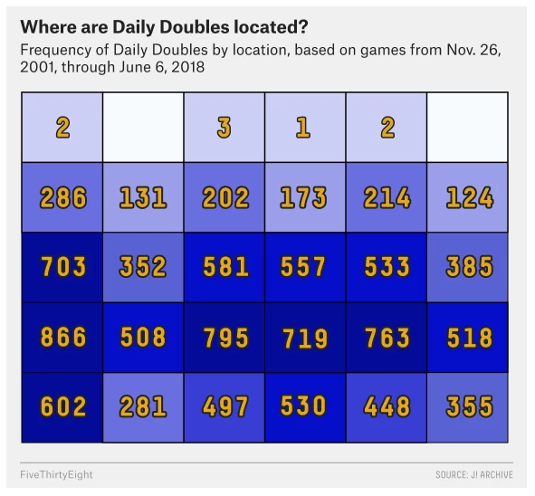
Bayes’ Theorem: Jeopardy.
From: https://fivethirtyeight.com/features/the-man-who-solved-jeopardy/
James Holzhauer
A map of where all 11,000+ Daily Doubles have been uncovered on the “Jeopardy!” game board since 2001.
You’ve gathered the data.
You’ve seen the data: DDs aren’t totally random.
Given this “heat map,” how would you make your picks?

Slide 28
Bayes’ Theorem: Jeopardy
Footnotes/credit from thefivethirtyeight.com
And Jacob Bovee’s J-Archive-Parser.
https://github.com/jbovee/j-archive-parser
https://j-archive.com
https://jboard.tv/viewforum.php?f=1&sid=5192983f26fb896d525a6fb68f8882cc
Reddit-style boards

Slide 29
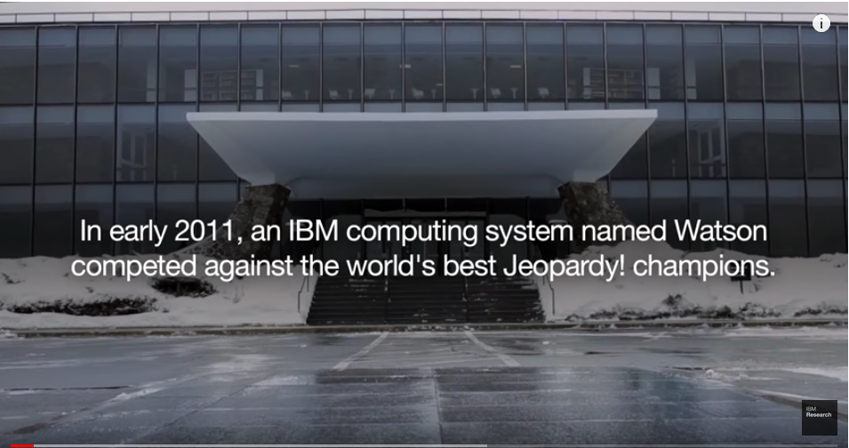
This. . . is Jeopardy!
For more, see : http://www.research.ibm.com/artificial-intelligence/

Slide 30
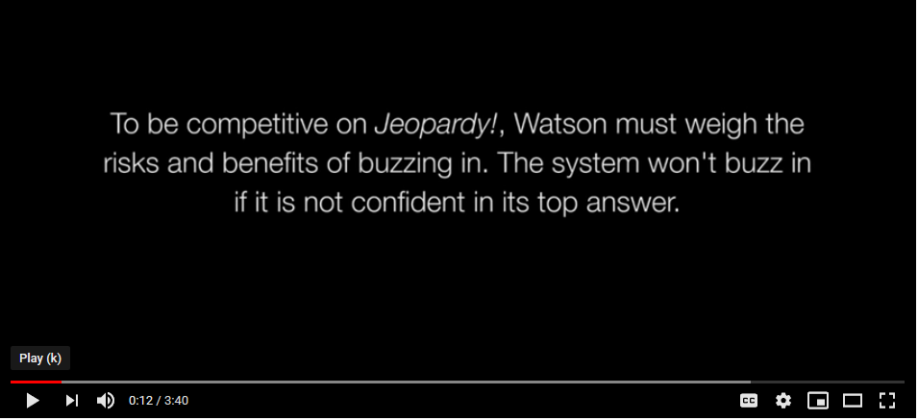
This. . . is Jeopardy!
For more, see : https://www.youtube.com/watch?v=7kOEmupSHB8

Slide 31
This. . . is Jeopardy!
For more, see : http://www.research.ibm.com/artificial-intelligence/

Slide 32
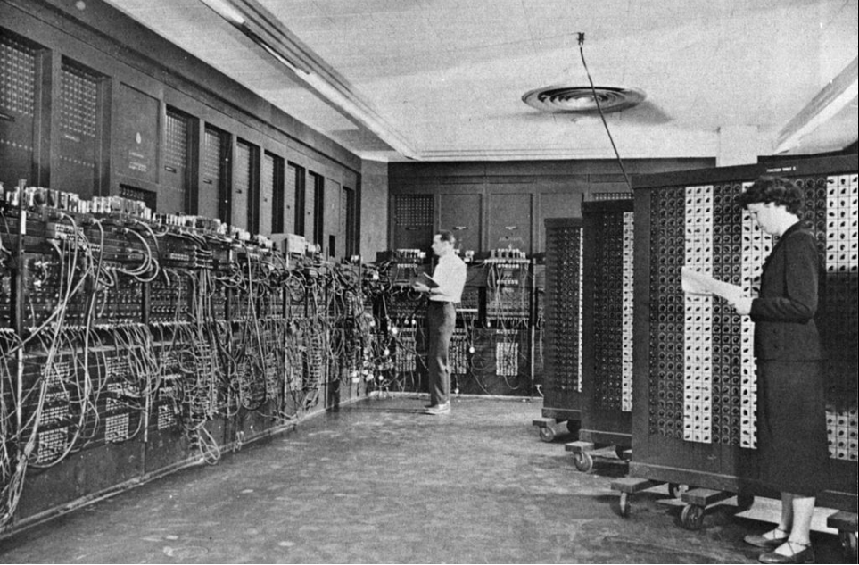
This. . . is Jeopardy!
Inside Watson… for more see: https://www.youtube.com/watch?v=P18EdAKuC1U

Slide 33
Conditional Probability & Bias: picture view
Given: two coins in a bag?
One regular coin (head/tail)
One two-headed coin (A biased coin)
What are the odds someone randomly selects the regular coin?
Probably 0.5
If that was all of the information we have, sure!
Let’s provide a little more information! (like we did with the Monty Hall Problem)
We flip a coin once. The result is: HEADS
Now, what is the probability that the regular coin was selected?
Let’s draw a structure of outcomes and see!

Slide 34
Conditional Probability & Bias: picture view
After selectiong one of two coins, flip the coin once.
4 possible outcomes.
But the result is: HEADS
What is the probability the regular coin was selected now ?
Select Coin
Regular
H
T
Biased
H
H

Slide 35
Conditional Probability & Bias: picture view
After selectiong one of two coins, flip the coin once.
4 possible outcomes.
But the result is: HEADS
What is the probability the regular coin was selected now ?
Tails was not selected!
Only one possibility remains (in blue)
Out of 3! (blue + red tiles)
Select Coin
Regular
H
T
Biased
H
H

Slide 36
Managing Expectations: Expected Value (6.8)
When the elements in a sample space have probabilities associated with them (e.g., the chance that a lottery ticket is a winner)
... and those outcomes have values (or payoffs) associated with them,
... we can talk about the expected value (or expectation) of an outcome: the probability-weighted average value of the payoff function

Slide 37
Expected Value
The verbiage:
Let S be a sample space, p be a probability distribution on S
... and let f be a payoff function that maps each element of S to a real number
Then: expected value of f given p is f(s)*p(s),summed over all s in S
Using math (singular!)
μ = μ(f,p) = ∑_{s∈S}f(s)*p(s)

Slide 38
Managing Expectations: Expected Value
Other ways to describe the expected value:
The sum of each outcome * frequency the outcome occurs.
The mean of an infinite sequence of a random variable.
The long run average of many many many repetitions of an experiment (GEN-AND-TEST)
Fun Fact: the most probable value does not have to be the expected value. (they are not the same)
An example: flip a regular (i.e. fair) coin 2 times. Again :(
The ordered pairs: (H,H) (H,T) (T,H) (T,T)
Possible values: We could get 2 heads, 1 head, or 0 heads. The expected value of flipping heads:
∑_{s∈S}f(s)*p(s) = 2*.25 + 1*.5 + 0*.25 = 1

Slide 39
Expected Value: déjà vu all over again
Another example: flip a regular (i.e. fair) coin 3 times. Again :(
The ordered 3-tuples:
(H,H,H)
(H,H,T) (H,T,H) (T,H,H)
(T,T,H) (T,H,T) (H,T,T)
(T,T,T)
Possible values: We could get 3, 2, 1 or 0 heads. The expected value of flipping heads:
∑_{s∈S}f(s)*p(s) = 3*(1/8) + 2*(3/8) + 1*(3/8) + 0*(1/8) = 3/2

Slide 40
Expected Values & Tonight’s Lab
Part 1: Representing numbers
Using our fingers, we’re used to using decimal numbers: base 10.
Or maybe sexagesimal numbers: base 60.
You don’t have to be a Sumerian either!
Computers are used to using binary numbers: base 2.
It is just a matter of figuring out what the numbers represent.
Or maybe hexadecimal numbers: base 16.
We can make computers use decimal numbers.
See Java’s BigDecimal.
See IEEE-754 revision 2.

Slide 41
Hexadecimal numbers
Decimal 123
= 1 * 10² + 2 * 10¹ + 3*10⁰
To hexadecimal 7B
= 7 * 16¹ + B * 16⁰
Wait.What? Oh. Decimal 10 through 15 are represented by letters A through F
To binary 0111 1011
= 1 * 2⁶ + 1 * 2⁵ + 1 * 2⁴ + 1 * 2³ + 0 * 2² + 1 * 2¹ + 1 * 2⁰
Floating point numbers have the same representation
Except that the exponent is negative.
Since 1 * 2⁰ = 1, 1 * 2⁻¹ = 1/2 1 * 2⁻² = 1/4 , etc.
Binary numbers could be represented by H & T instead of 0 & 1.
Or vice versa.

Slide 42
Tonight’s Lab Part 2: Simulating a rigged coin w/ a regular coin
Consider a fair coin. And you want to simulate a rigged coin s.t.
Probability that H occurs 1/4 of the time.
Well, if we flip 2x. . . HH occurs 1/4 of the time. Success! Simply fail on HT, TH, or TT.
Actually, you could do a form of short circuiting: simply fail if first flip = T
The binary fractions allow us to do this,
Simply by using a binary representation
1/4 = 1 * 2⁻² = 0.01 (or simply 01)
GEN-AND-TEST allows us to run such tests.
What-about-ism:
What about a rigged coin s.t. H occurs 1/3 of the time?
The Flip Side: we can figure out what a mystery value is, i.e. what an infinitely long binary string of 0’s, 1’s represent . . .
By computing the expected value of fair coin flips that it would take to simulate a biased coin.
More on Thursday…

