Slide 1
CMPU-145: Foundations of Computer Science Spring, 2019
8: Propositional Logic

Slide 2
Propositional Logic
Logic: The study of reasoning. Also the study of how one may develop a belief, or knowledge, system, via
Inference (the process by which a proposition is accepted)
Belief organization (putting what we know/believe into a pattern)
Belief change (something previously accepted as true, no longer is true) via contraction, revision
Logic allows us to learn that which we do not know with absolute conclusions . . .
By studying formal systems of inference (like we had done this semester) and. . .
By studying arguments made with propositions:
i.e. Declarative statements that make an assertion that is true or false.
BASIC ASSUMPTION: principle of bivalence: every proposition is:
True or false, exclusively (not both at the same time.)

Slide 3
Propositional Operators
Restated: A proposition is a statement that has the property of being true or false.
We use propositional letters (or variables) to represent propositions
A stands for the statement: This computer is defective
Boolean operators are used construct new propositions from existing ones:
Negation or “not”: if P is a proposition, not P is a proposition
Conjunction “and”: P and Q
Disjunction “or”: P or Q
Implication “if/then”: if P then Q
Equivalence “is equal/equivalent to”: P iff Q
Let’s review each one !

Slide 4
Negation
The negation of a proposition p is ¬p
Given proposition p, the statement, “it is not the case that p…” is ¬p
Is it the case that this is new information, or
Is it not the case that this is new information?
Time for the truth (table)
Notation: 1 for True, 0 for False
p | ¬p
1 | 0
0 | 1

Slide 5
Conjunction Junction
Conjunction :“and operator”
Given some value for propositions p, q
conjunction p and q (p ^ q or p && q) is also a proposition
If p is Today is Thursday and q is “It is raining today” p ^ q is:
Today is Thursday and it is raining today.
p ^ q is true on rainy Thursdays,
And false on any day that is not Thursday and on any Thursday when it is not raining
p | q | p^q
1 | 1 | 1
1 | 0 | 0
0 | 1 | 0
0 | 0 | 0

Slide 6
Disjunction
Disjunction :“or operator”
Given some value for propositions p, q
disjunction p or q (p v q or p || q) is also a proposition
If p is Today is Thursday and q is “It is raining today” p v q is:
Today is Thursday or it is raining today.
p v q is true on Thursdays, rainy days, and rainy Thursdays,
And false on any day that is not Thursday and not raining
p | q | p V q
1 | 1 | 1
1 | 0 | 1
0 | 1 | 1
0 | 0 | 0

Slide 7
Implication
Implication : “if/then” operator, or conditional operator
Given some value for propositions p, q
disjunction p or q (p -> q) is also a proposition
If p is “It is raining today” and q is “the streets are wet” p -> q is:
If it is raining today, then the streets are wet.
p is referred to as the hypothesis q is the conclusion
The truth table is the same as (¬p V q)
Again, maybe not so easy to grasp...(The whole Super Bowl -> Dollar thing)
p | q | p -> q
1 | 1 | 1
1 | 0 | 0
0 | 1 | 1
0 | 0 | 1

Slide 8
Properties of our operators
Logical operators have an order of operations.
“As do I,” said the mathematical operators
From high to low: negation; conjunction; disjunction; implication
Conjunction is sorta-kinda like multiplication; disjunction is sorta-kinda like addition
Math: -k * (x + y) vs. Logic: ¬p ^ (q V r)
Disjunction and conjunction are commutative and associative
Associative: e.g., p ^ q ^ r == (p ^ q) ^ r == p ^ (q ^ r)
Commutative: e.g., p ^ q == q ^ p
Implication is right-associative
p -> q -> r == p -> (q -> r)

Slide 9
The biconditional (or equivalence) operator
The biconditional (or equivalence) operator: == <-> iff
If p and q are propositions, then p == q is a proposition,
p == q is true exactly when p and q have the same truth values

Slide 10
The set of propositional logic (formulae)
Definition: the formulae of propositional logic is the closure of:
The set A of propositions (referred by by letters: p, q, etc.) under the set of logic operators,
( And parentheses too.)
I.e. the proper subset of all strings in the
alphabet B = A U {¬ , ^, v} U {(,)}

Slide 11
Tautology
A tautology is a propositional formula (or assertion) that is always true under any interpretation, i.e. under all boolean valuations of propositional variables (p, q, etc).
One way to verify a tautology: truth tables!
Makinson describes these tautologicality concepts
Tautological implication
Tautological equivalence
The property of being a tautology
The property of being a contradiction (as in the Star Trek snippet)

Slide 12
Tautological implication (or consequence)
Definition*: A formula R tautologically implies formula S if every valuation that causes R to be true also causes S to be true.
R ⊨ S
Examples (Note: for each, any valuation that makes LHS true makes RHS true also (for LHS ➔ RHS)
Transitivity: R->T, T->S ➔ R-> S and R ⊨ S
And: 1) A^B ➔ A 2) A^B ➔ B, A^B ⊨ A, A^B ⊨ B
Q: let R = A^C, S = A^(Bv ¬B). Is R ⊨ S?

Slide 13
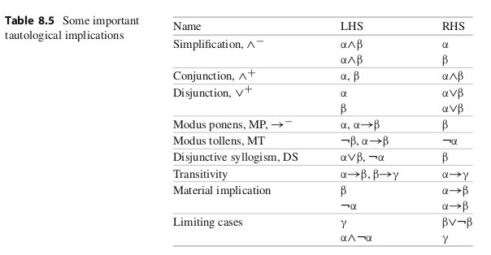
MoreTautological implication (from Makinson)

Slide 14
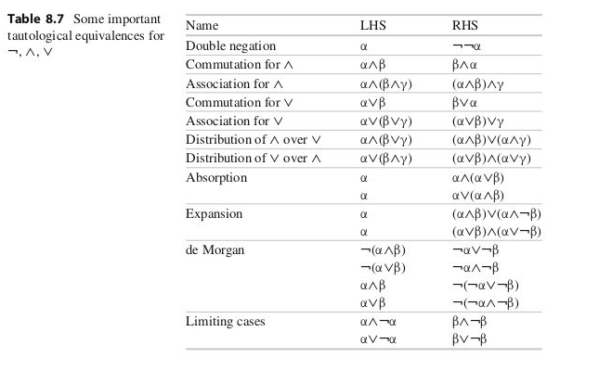
Tautological Equivalence
When each of two formulae tautologically implies the other, we have a tautological equivalence.
One might see such
substitutions when a compiler
optimizes some code

Slide 15
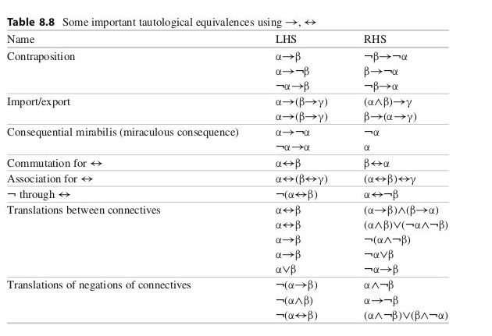
More Tautological Equivalence
When each of two formulae tautologically implies the other, we have a tautological equivalence.
One might also see these
substitutions when a compiler
optimizes some code (whichever is
Simpler.

Slide 16
Those other properties: Tautology or Contradiction?
Let R be any formula. Then:
R is a tautology iff v(R) = 1 for every valuation v, i.e. iff
every row of R’s truth table is 1.
R is a contradiction iff v(R) = 0 for every valuation v, i.e. iff
Every row of of R’s truth table is 0.
R is contingent iff it is neither a tautology nor a contradiction. , i.e. iff
Some rows of R’s truth table is 1 and some rows of R’s truth table is 0.

Slide 17
Tautology or Contradiction or Contingent?
p v ¬p
¬(p v ¬p)
p v ¬q
¬(p v ¬q)
(p^(¬p v q)) -> q
¬(p v q) <-> (¬p ^ ¬q)
p ^ ¬p
p -> ¬p
p <-> ¬p
(r^s) v ¬(r^s)
(r->s) <-> ¬(r->s)

Slide 18
Tautology or Contradiction or Contingent?
p v ¬p
¬(p v ¬p)
p v ¬q
¬(p v ¬q)
(p^(¬p v q)) -> q
¬(p v q) <-> (¬p ^ ¬q)
p ^ ¬p
p -> ¬p
p <-> ¬p
(r^s) v ¬(r^s)
(r->s) <-> ¬(r->s)

Slide 19
Tautology or Contradiction or Contingent?
p v ¬p
¬(p v ¬p)
p v ¬q
¬(p v ¬q)
(p^(¬p v q)) -> q
¬(p v q) <-> (¬p ^ ¬q)
p ^ ¬p
p -> ¬p
p <-> ¬p
(r^s) v ¬(r^s)
(r->s) <-> ¬(r->s)

Slide 20
Tautology or Contradiction or Contingent?
p v ¬p
¬(p v ¬p)
p v ¬q
¬(p v ¬q)
(p^(¬p v q)) -> q
¬(p v q) <-> (¬p ^ ¬q)
p ^ ¬p
p -> ¬p
p <-> ¬p
(r^s) v ¬(r^s)
(r->s) <-> ¬(r->s)

Slide 21
More Tautology or Contradiction or Contingent?
p v ¬p
¬(p v ¬p)
p v ¬q
¬(p v ¬q)
(p^(¬p v q)) -> q
¬(p v q) <-> (¬p ^ ¬q)
p ^ ¬p
p -> ¬p
p <-> ¬p
(r^s) v ¬(r^s)
(r->s) <-> ¬(r->s)
A formula is a tautology iff its negation is a contradiction : examples a. and b.

Slide 22
Disjunctive Normal Form (DNF)
Normal form of an expression: a remix that is still equivalent to the original expression, just more simple.
Literal: a letter, like p, or its negation, like ¬p
A basic conjunction doesn’t have any literals appearing more than once.
A formula is in DNF iff it is a disjunction of one or more basic conjunctions.
eg, p, ¬p, p v ¬p : all in dnf
eg, ((p^q) v ¬r ), (¬p^¬q^p) : NOT dnf
Notes:
Not dnf’s because a) there’s a disjunction inside a conjunction, and b) multiple occurrances of p

Slide 23
Conjunctive Normal Form (CNF)
Like DF but turned ‘upside down’, also: an AND of ORs
More formally,
A formula is in CNF iff it is a conjunction of one or more basic disjunctions.
A formula is a full CNF of A iff every literal of A occurs in each of the basic disjunctions.
Every formula can be equivalently written as a formula in conjunctive normal form
eg, ¬(p v q) -> ¬p ^ ¬q)
eg, (p^q) v r -> (p v r) ^ (q v r)

Slide 24
Next Tuesday
Let’s review for the final exam.
I will also return homework assignments & handout labs & homework points.
What shall we do for the lab?

