Slide 1
CMPU-145: Foundations of Computer Science Spring, 2019
8: Propositional Logic a few more thoughts

Slide 2
Propositional Logic
Some charts from last week…
Plus a few exemplar boolean expressions.

Slide 3
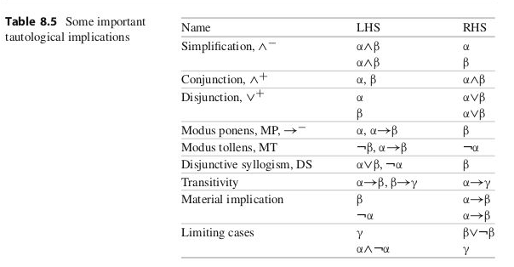
MoreTautological implication (from Makinson)

Slide 4
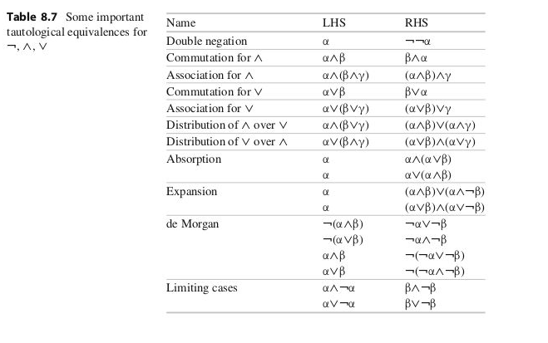
Tautological Equivalence
When each of two formulae tautologically implies the other, we have a tautological equivalence.
One might see such
substitutions when a compiler
optimizes some code

Slide 5
A closer examination of de Morgan’s Equivalences
Makinson refers to systematic correspondence (i.e. they are analogous) between
tuatological equivalence and
boolean identities between sets
Arguably, the most important are de Morgan’s equivalences. From set theory (p20)
-∪_{i∈I} {B_{i}} = ∩ _{i∈I} {-B_{i}} or –(A ∪ B) = -A ∩ -B
-∩_{i∈I} {B_{i}} = ∪ _{i∈I} {-B_{i}} or –(A ∩ B) = -A ∪ -B
And, restated, using English alphabet.
¬(p v q) = ¬p ^ ¬q
¬(p ^ q) = ¬p v ¬q
We can use these equivalences to simplify boolean expressions ourselves.

Slide 6
Simplifying Boolean Expressions: Cheat Sheet
Or
p v p == p
p v ¬p == 1
p v 1 == 1
p v 0 == p
p v q == q v p
(pvq)v r == p v (q v r)
And
q ^ q == q
q ^ ¬q == 0
q ^ 1 == q
q ^ 0 == 0
p ^ q == q ^ p
p^(q^r) == (p^q)^r
With de Morgan (again)
¬(p v q) == ¬p ^ ¬q
¬(p ^ q) == ¬p v ¬q
Double negation
¬ ¬ p == p (double negation)
Absorption (*3)
P^(p v q) == p
p v (p^q) == p
p v (¬p^q)== p v q

Slide 7
Simplifying Boolean Expressions: 2 Examples
p^q^r v ¬p v p^¬q^r == ?
p^q v p^(q v r) v q^(q v r) == ?
Imagine if we were assigned the task of optimizing expressions like this as part of a compiler.
We can apply Table 8.7 (or our cheat sheet!) to simplify these expressions.

Slide 8
Simplifying Boolean Expressions: Example 1
p^q^r v ¬p v p^¬q^r == (associativity)
p^q^r v p^¬q^r v ¬p == (distrib. of ^ over v. . .)
p^r^(q v ¬q) v ¬p == (. . . from right to left)
p^r^(1) v ¬p == (p v ¬p == 1)
p^r v ¬p == (p^1 == p)
¬p v p^r == (associativity)
¬¬p v ¬p^r == (replace p with (¬p) to see…)
¬p v r (answer) == (another form of absorption rule)

Slide 9
Simplifying Boolean Expressions: Example 2
p^q v p^(q v r) v q^(q v r) == (distribution of ^ over v)
p^q v p^q v p^r v q^q v q^r == (left to right this time!)
p^q v p^q v p^r v q^q v q^r == (p ^ p == p)
p^q v p^q v p^r v q v q^r == (p v p == p)
p^q v p^r v q v q^r == (de Morgan)
p^q v p^r v q == (associativity)
q v p^q v p^r == (de Morgan)
q v p^r == (answer)

Slide 10
Definitions: Also From Last Week
Additional Let R be any formula. Then:
R is a tautology iff v(R) = 1 for every valuation v, i.e. iff
every row of R’s truth table is 1 (always TRUE).
R is a contradiction iff v(R) = 0 for every valuation v, i.e. iff
Every row of of R’s truth table is 0 (always FALSE).
R is contingent iff it is neither a tautology nor a contradiction. , i.e. iff
Some rows of R’s truth table is 1 and some rows of R’s truth table is 0.
(i.e. Sometimes TRUE, sometimes FALSE, depending on input).

Slide 11
Tautology or Contradiction or Contingent?
p v ¬p
¬(p v ¬p)
p v ¬q
¬(p v ¬q)
(p^(¬p v q)) -> q
¬(p v q) <-> (¬p ^ ¬q)
p ^ ¬p
p -> ¬p
p <-> ¬p
(r^s) v ¬(r^s)
(r->s) <-> ¬(r->s)

Slide 12
Tautology or Contradiction or Contingent?
p v ¬p
¬(p v ¬p)
p v ¬q
¬(p v ¬q)
(p^(¬p v q)) -> q
¬(p v q) <-> (¬p ^ ¬q)
p ^ ¬p
p -> ¬p
p <-> ¬p
(r^s) v ¬(r^s)
(r->s) <-> ¬(r->s)

Slide 13
Tautology or Contradiction or Contingent?
p v ¬p
¬(p v ¬p)
p v ¬q
¬(p v ¬q)
(p^(¬p v q)) -> q
¬(p v q) <-> (¬p ^ ¬q)
p ^ ¬p
p -> ¬p
p <-> ¬p
(r^s) v ¬(r^s)
(r->s) <-> ¬(r->s)

Slide 14
Tautology or Contradiction or Contingent?
p v ¬p
¬(p v ¬p)
p v ¬q
¬(p v ¬q)
(p^(¬p v q)) -> q
¬(p v q) <-> (¬p ^ ¬q)
p ^ ¬p
p -> ¬p
p <-> ¬p
(r^s) v ¬(r^s)
(r->s) <-> ¬(r->s)

Slide 15
Why Repeat This Stuff?
On the final exam,
There is one question on simplifying boolean expressions
There is another question on identifying boolean expressions as a Tautology or a Contradiction or a Contingent.

