Slide 1
Introduction

Slide 2
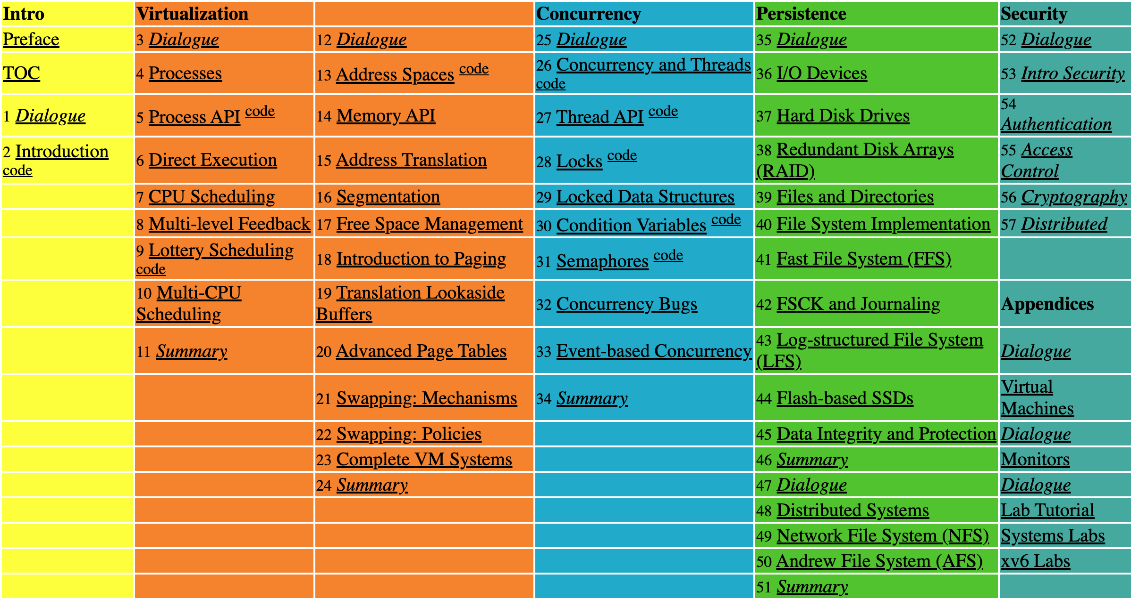
Textbook
Operating Systems: Three Easy Pieces
Remzi and Andrea Arpaci-Dusseau
Freely available at: http://ostep.org
Printed softcover book: $22
PDF: $10

Slide 3
Review: What a happens when a program runs?
A running program executes instructions
The processor fetches an instruction from memory
Decode: Figure out which instruction this is
Execute: i.e., add two numbers, access memory, check a condition, jump to function, and so forth
The processor moves on to the next instruction and so on
CPU
Register file
ALU
PC
System bus
Memory bus
Bus interface
I/O
bridge
Main
memory
I/O bus
Expansion slots for
other devices such
as network adapters
USB
controller
Graphics
adapter
Disk
controller
Mouse
Keyboard
Display
Disk
executable
stored on disk

Slide 4
What layer is the OS?
Application
Physics

Slide 5
What layer is the OS?
Application
Gap too large to
bridge in one step
Physics

Slide 6
What layer is the OS?
Application
Algorithm
Programming Language
Operating System
Instruction Set Architecture
Microarchitecture
Register-Transfer Level
Gates
Circuits
Devices
Physics

Slide 7
What layer is the OS?
Application
Algorithm
Programming Language
Operating System
CMPU-334 Operating Systems
Instruction Set Architecture
CMPU-224 Computer Organization
Microarchitecture
Register-Transfer Level
Gates
Circuits
Devices
Physics

Slide 8
What is an OS?
Definition: An Operating System is software that manages computer resources:
The processor, or more accurately, processors (CPUs)
Main Storage (Core Storage), or memory
External Storage
I/O Devices: Display Screens, Printers, Keyboards, Mouse, Camera, etc.
Data
Additional Features:
Schedule resource usage
Recover From Errors
(The dreaded MS “Blue Screen Of Death” is dreaded because there is no recovery!)
Maintainability/Reliability
Share “resources”… or not. (Which resources?)

Slide 9
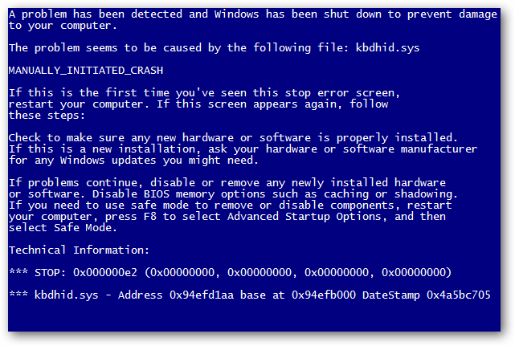

Slide 10
Operating System (OS)
Responsible for
Making it easy to run programs
Allowing programs to share memory
Enabling programs to interact with devices
The OS is in charge of making sure the system operates correctly and efficiently

Slide 11
Virtualization
The OS takes a physical resource and transforms it into a virtual form of itself
Physical resource: Processor, Memory, Disk …
The virtual form is more general, powerful and easy-to-use
Sometimes, we refer to the OS as a virtual machine

Slide 12
System call
System call allows user to tell the OS what to do
The OS provides some interface (APIs, standard library)
A typical OS exports a few hundred system calls
Run programs
Access memory
Access devices

Slide 13
The OS as a resource manager
The OS manage resources such as CPU, memory and disk
The OS allows
Many programs to run → Sharing the CPU
Many programs to concurrently access their own instructions and data → Sharing memory
Many programs to access devices → Sharing disks

Slide 14
Virtualizing the CPU
The system has a very large number of virtual CPUs
Turning a single CPU into a seemingly infinite number of CPUs
Allowing many programs to seemingly run at once → Virtualizing the CPU

Slide 15
Virtualizing the CPU Example
#include <stdio.h>
#include <stdlib.h>
#include "common.h"
// To compile:
// gcc -Og -Wall -o cpu cpu.c -lpthread
int main(int argc, char *argv[]) {
if (argc != 2) {
fprintf(stderr, "usage: cpu <string>\n");
exit(1);
}
char *str = argv[1];
while (1) {
printf("%s\n", str);
Spin(1); // Repeatedly checks the time and returns after one second
}
return 0;
}

Slide 16
Virtualizing the CPU (Cont.)
Execution result 1
prompt> gcc -o cpu cpu.c -Wall
prompt> ./cpu "A"
A
A
A
ˆC
prompt>
Run forever; Only by pressing “Control-c” can we halt the program

Slide 17
Virtualizing the CPU (Cont.)
Execution result 2
prompt> ./cpu A & ./cpu B & ./cpu C & ./cpu D &
[1] 7353
[2] 7354
[3] 7355
[4] 7356
A
B
D
C
A
B
D
C
A
C
B
D
...
Even though we have only one processor, all four of programs seem to be running at the same time!

Slide 18
Virtualizing Memory
The physical memory is an array of bytes
A program keeps all of its data (structures) in memory: i.e. main storage
At the architecture level, assembly language instructions will
Read memory via load instructions:
Specify an address to be able to access the data
Write memory via store instructions:
Specify the data to be written to the given address

Slide 19
Virtualizing Memory (Cont.)
#include <unistd.h>
#include <stdio.h>
#include <stdlib.h>
#include <assert.h>
#include "common.h"
// To compile: gcc -Og -Wall –no-pie -o mem mem.c -lpthread
int value;
int main(int argc, char *argv[]) {
if (argc != 2) {
fprintf(stderr, "usage: mem <value>\n");
exit(1);
}
printf("\n(pid:%d) addr of value: %p\n", (int) getpid(), &value);
value = atoi(argv[1]); // assign value to addr stored in p
while (1) {
Spin(1);
value = value + 1;
printf("(pid:%d) value of p: %d\n", getpid(), value);
}
return 0;
}

Slide 20
Virtualizing Memory (Cont.)
Each process accesses its own private virtual address space
The OS maps address space onto the physical memory
A memory reference within one running program does not affect the address space of other processes
Physical memory is a shared resource, managed by the OS
prompt> ./mem 100 & ./mem 200 &
[1] 18217
[2] 18218
(pid:18217) addr of value: 60108c
(pid:18218) addr of value: 60108c
(pid:18217) value of p: 101
(pid:18218) value of p: 201
(pid:18217) value of p: 102
(pid:18218) value of p: 202
(pid:18217) value of p: 103
(pid:18218) value of p: 203
...

Slide 21
Phase 1: Hardware expensive, humans Cheap
One user at a time
First “OS”: I/O subroutines shared by users
Simple batch monitor
Load and run user jobs
Timesharing – several users share the system

Slide 22
Phase 2: Hardware cheap, humans expensive
PC era: everyone one gets their own computers
Are all the fancy features developed for timesharing still needed?
Future of OSes:
Very small (embedded devices)
Very large (datacenters, cloud computing)
Current OSes:
Huge: millions of lines of code
Complex: asynchronous, quirky hardware, performance is key
Poorly understood
Most OS functions fall in the category of coordination
Concurrency, I/O devices, Memory, Files, Networks, Security

