Slide 1
Scheduling: Introduction

Slide 2
How to develop a scheduling policy
How should we develop a basic framework for thinking about scheduling policies?
What are the key assumptions?
What metrics are important?
What basic approaches have been used in the past?

Slide 3
Workload
Initial workload assumptions (we’ll relax these assumptions later):
Each job runs for the same amount of time
All jobs arrive at the same time
Once started, each job runs to completion
All jobs only use the CPU (i.e., they don’t perform no I/O)
The run-time of each job is known

Slide 4
Scheduling Metrics
Performance metric: Turnaround time
The time at which the job completes minus the time at which the job arrived in the system
Another metric is fairness (e.g., Jain’s Fairness Index)
Maximum when all jobs receive the same share of CPU allocation
Performance and fairness are often at odds in scheduling
$$T_{turnaround}=T_{completion}−T_{arrival}$$

Slide 5
First In, First Out (FIFO)
First Come, First Served (FCFS)
Very simple and easy to implement
Example:
A arrived just before B which arrived just before C
Each job runs for 10 seconds
A
B
C
0
20
40
60
80
100
120
Time (Second)
$$Average turnaround time=\frac{10+20+30}{3}=20 sec$$

Slide 6
Why FIFO is not that great? – Convoy effect
Let’s relax assumption #1 (all jobs run for the same time)
Each job no longer runs for the same amount of time
Example:
A arrived just before B which arrived just before C
A runs for 100 seconds, B and C run for 10 each
A
B
C
0
20
40
60
80
100
120
Time (Second)
$$Average turnaround time=\frac{100+110+120}{3}=110 sec$$

Slide 7
Shortest Job First (SJF)
Run the shortest job first, then the next shortest, and so on
Non-preemptive scheduler (no interrupting a running job)
Example:
A arrived just before B which arrived just before C
A runs for 100 seconds, B and C run for 10 each
B
C
A
0
20
40
60
80
100
120
Time (Second)
$$Average turnaround time=\frac{10+20+120}{3}=50 sec$$

Slide 8
SJF with Late Arrivals from B and C
Let’s relax assumption #2 (all jobs arrive at the same time)
Jobs can now arrive at any time
Example:
A arrives at t=0 and needs to run for 100 seconds
B and C arrive at t=10 and each need to run for 10 seconds
[B,C arrive]
A
B
C
0
20
40
60
80
100
120
Time (Second)
$$Average turnaround time=\frac{100+\left(110−10\right)+(120−10)}{3}=103.33 sec$$

Slide 9
Shortest Time-to-Completion First (STCF)
Let’s relax assumption #3 (once started, each job runs to completion)
Add preemption to SJF
Also knows as Preemptive Shortest Job First (PSJF)
When a new job enters the system:
Determine the time to complete the remaining jobs and new job
Schedule the job which has the least remaining time left
Provably optimal with regard to minimizing turnaround time
Notes:
Probably can combine this slide with the next one.

Slide 10
Shortest Time-to-Completion First (STCF)
Example:
A arrives at t=0 and needs to run for 100 seconds
B and C arrive at t=10 and each need to run for 10 seconds
[B,C arrive]
A
B
C
A
0
20
40
60
80
100
120
Time (Second)
$$Average turnaround time=\frac{(120−0)+\left(20−10\right)+(30−10)}{3}=50 sec$$

Slide 11
New scheduling metric: Response time
The time from when the job arrives to the first time it is scheduled
STCF and related disciplines are not particularly good for response time
$$T_{response}=T_{firstrun}−T_{arrival}$$
How can we build a scheduler that is
sensitive to response time?

Slide 12
Round Robin (RR) Scheduling
Time slicing Scheduling
Run a job for a time slice and then switch to the next job in the run queue until the jobs are finished
Time slice is sometimes called a scheduling quantum
It repeatedly does so until the jobs are finished
The length of a time slice must be a multiple of the timer-interrupt period
RR is fair, but performs poorly on metrics
such as turnaround time

Slide 13
RR Scheduling Example
A, B and C arrive at the same time
They each wish to run for 5 seconds
A
B
C
$$T_{average response}=\frac{0+5+10}{3}=5sec$$
0
5
10
15
20
25
30
Time (Second)
SJF (Bad for Response Time)
A
B
A
B
A
B
A
B
A
C
C
C
C
B
C
$$T_{average response}=\frac{0+1+2}{3}=1sec$$
0
5
10
15
20
25
30
Time (Second)
RR with a time-slice of 1sec (Good for Response Time)
Notes:
Next time, lead with the example and then explain the properties.

Slide 14
The length of the time slice is critical
The shorter time slice
Better response time
The cost of context switching will dominate overall performance
The longer time slice
Amortize the cost of switching
Worse response time
Deciding on the length of the time slice presents
a trade-off to a system designer

Slide 15
Incorporating I/O
Let’s relax assumption #4 (all jobs only use the CPU)
Jobs can now perform I/O
Example:
Jobs A and B need 50ms of CPU time each
A runs for 10ms and then issues an I/O request
I/Os each take 10ms
B simply uses the CPU for 50ms and performs no I/O
The scheduler runs A first, then B after

Slide 16
Incorporating I/O (Cont.)
A
A
A
A
A
B
B
B
B
B
0
20
40
60
80
100
120
140
Time (msec)
Poor Use of Resources
A
B
A
B
A
B
A
B
A
B
Maximize the
CPU utilization
0
20
40
60
80
100
120
140
Time (msec)
Overlap Allows Better Use of Resources

Slide 17
Incorporating I/O (Cont.)
When a job initiates an I/O request
The job is blocked waiting for I/O completion
The scheduler should schedule another job on the CPU
When the I/O completes
An interrupt is raised
The OS moves the process from blocked back to the ready state

Slide 18
What’s Next?
Remove our final assumption: the scheduler knows the length of each job
The OS usually knows very little about the length of each job
How can we behave like SJF/STCF without such knowledge?
How can we be fair and also have good response time?

Slide 19
Multi-Level Feedback Queue (MLFQ)
A scheduler that learns from the past to predict the future
Objective:
Optimize turnaround time → Run shorter jobs first
Minimize response time without a priori knowledge of job length

Slide 20
MLFQ: Basic Rules
MLFQ has a number of distinct queues
Each queues is assigned a different priority level
A job that is ready to run is on a single queue
I.e., a job can be in only one queue at any given time
A job on the highest priority queue is chosen to run
Use round-robin scheduling among jobs in the same queue
Rule 1: If Priority(A) > Priority(B), A runs (B doesn’t)
Rule 2: If Priority(A) = Priority(B), A & B run in RR

Slide 21
MLFQ Example
[High Priority]
Q8
Q7
Q6
Q5
Q4
Q3
Q2
Q1
A
B
C
[Low Priority]
D

Slide 22
MLFQ: Basic Rules (Cont.)
MLFQ varies the priority of a job based on its observed behavior
Example:
A job repeatedly relinquishes the CPU while waiting for I/O
Keep its priority high
When it runs, it doesn’t run for very long
A job uses the CPU intensively for long periods of time
Reduce its priority

Slide 23
MLFQ: How to Change Priority
MLFQ priority adjustment algorithm:
Rule 3: When a job enters the system, it is placed in the highest priority queue
Rule 4a: If a job uses up an entire time slice while running, its priority is reduced (i.e., it moves down a queue level)
Rule 4b: If a job gives up the CPU before the time slice is up, it stays at the same priority level
In this manner, MLFQ approximates SJF

Slide 24
Example 1: A Single Long-Running Job
A three-queue scheduler with time slice 10ms
Q2
Q1
Q0
0
50
100
150
200
Long-running Job Over Time (msec)

Slide 25
Example 2: Along Comes a Short Job
Assumption:
Job A: A long-running CPU-intensive job
Job B: A short-running interactive job (20ms runtime)
A has been running for some time, and then B arrives at time T=100.
Q2
A:
Q1
B:
Q0
0
50
100
150
200
Along Comes An Interactive Job (msec)

Slide 26
Example 3: What About I/O?
Assumption:
Job A: A long-running CPU-intensive job
Job B: An interactive job that need the CPU only for 1ms before performing an I/O
Q2
A:
Q1
B:
Q0
0
50
100
150
200
A Mixed I/O-intensive and CPU-intensive Workload (msec)
The MLFQ approach keeps an interactive job at the highest priority

Slide 27
Problems with the Basic MLFQ
Starvation
If there are “too many” interactive jobs in the system
Lon-running jobs will never receive any CPU time
Game the scheduler
After running 99% of a time slice, issue an I/O operation (e.g., read(0))
The job gains a higher percentage of CPU time
A program may change its behavior over time
CPU bound process → I/O bound process

Slide 28
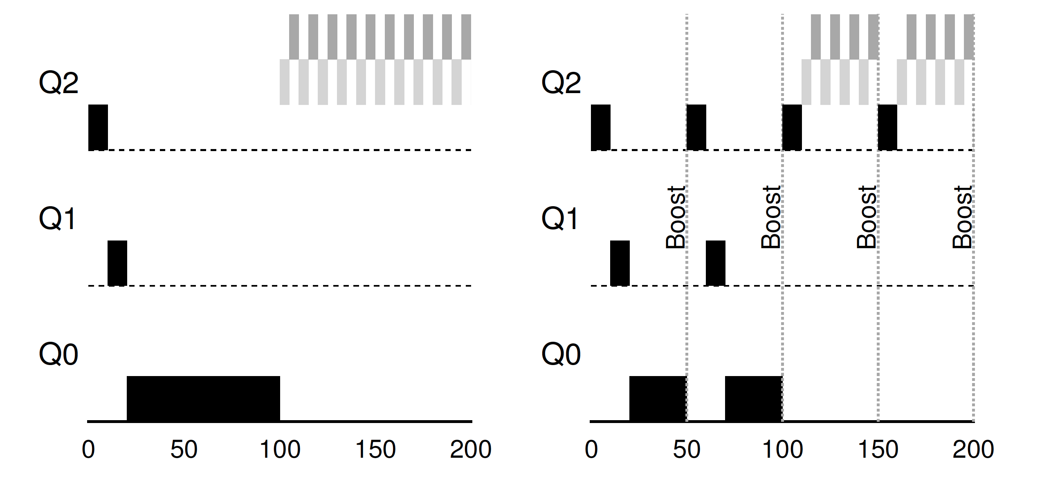
The Priority Boost
Rule 5: After some time period S, move all the jobs in the system to the topmost queue
Example:
A long-running job(A) with two short-running interactive job(B, C)
Without(Left) and With(Right) Priority Boost

Slide 29
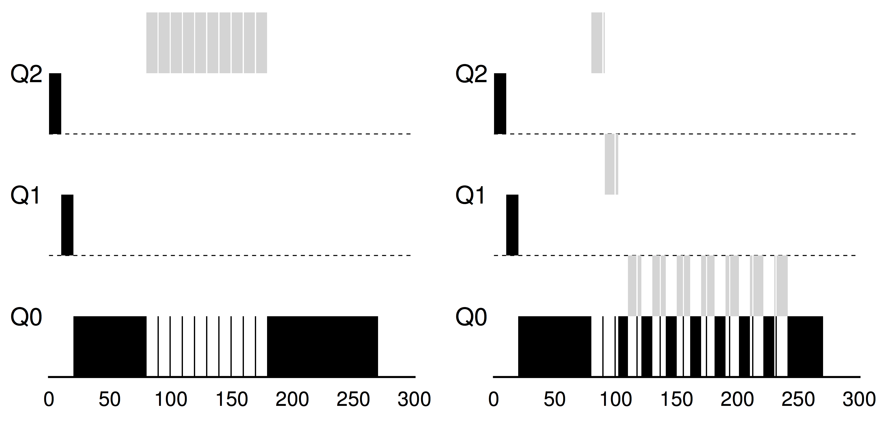
Better Accounting
How to prevent gaming of our scheduler?
Solution:
Rule 4 (Rewrite Rules 4a and 4b): Once a job uses up its time allotment at a given level (regardless of how many times it has given up the CPU), its priority is reduced(i.e., it moves down on queue)
Without(Left) and With(Right) Gaming Tolerance

Slide 30
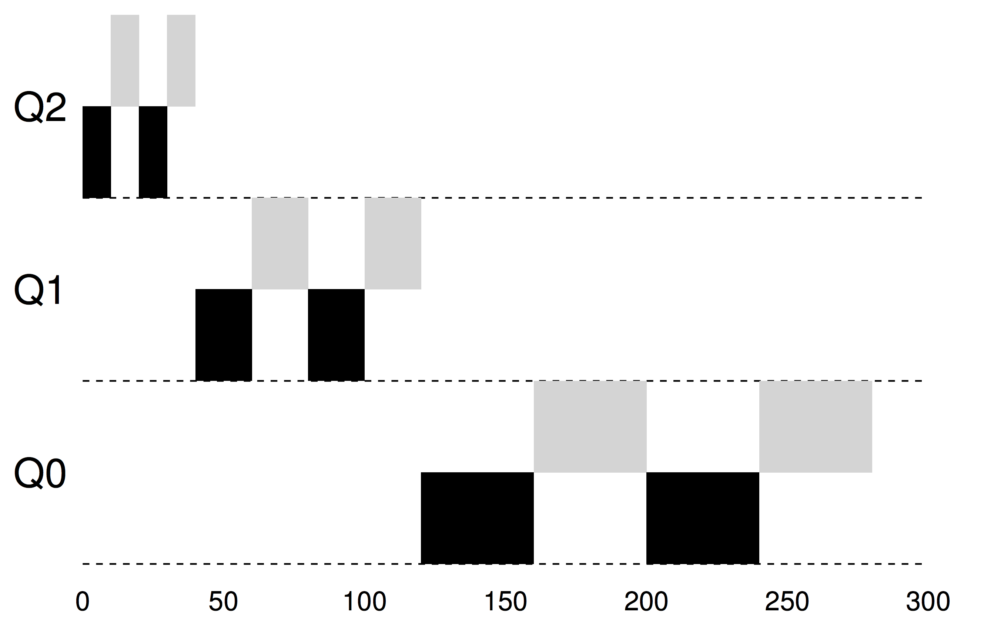
Tuning MLFQ And Other Issues
Lower Priority, Longer Quanta
The high-priority queues → Short time slices
E.g., 10 or fewer milliseconds
The Low-priority queue → Longer time slices
E.g., 100 milliseconds
Example: 10ms for the highest queue, 20ms for the middle,
40ms for the lowest

Slide 31
The Solaris MLFQ implementation
For the Time-Sharing scheduling class (TS)
60 Queues
Slowly increasing time-slice length
The highest priority: 20 msec
The lowest priority: A few hundred milliseconds
Priorities boosted around every 1 second or so

Slide 32
MLFQ: Summary
The refined set of MLFQ rules:
Rule 1: If Priority(A) > Priority(B), A runs (B doesn’t)
Rule 2: If Priority(A) = Priority(B), A & B run in RR
Rule 3: When a job enters the system, it is placed at the highest priority
Rule 4: Once a job uses up its time allotment at a given level (regardless of how many times it has given up the CPU), its priority is reduced(i.e., it moves down on queue)
Rule 5: After some time period S, move all the jobs in the system to the topmost queue

