Slide 1
The Linux Completely Fair Scheduler (CFS)

Slide 2
The Linux Completely Fair Scheduler (CFS)
Implements fair-share scheduling
Guarantees that each job obtains a certain percentage of CPU time
Efficient and scalable
Quickly make a scheduling decision
Scheduling performance is important
Scheduling uses about 5% of datacenter CPU time at Google

Slide 3
CFS Operation Basics
Fairly divides a CPU evenly among all competing (runnable) processes
Doesn’t use a fixed time slice
Uses the virtual runtime (vruntime) of a process
Accumulates as the process runs
To schedule a process, pick the one with the lowest vruntime
When to schedule?
Frequent switches increase fairness but has a higher overhead
Fewer switches give better performance at the cost of fairness
Controlled by sched_latency parameter
Maximum time a process can run before considering a switch (e.g., 20 ms)
This is divided by the number of runnable processes to get a process time slice
CFS will be completely fair over this time period

Slide 4
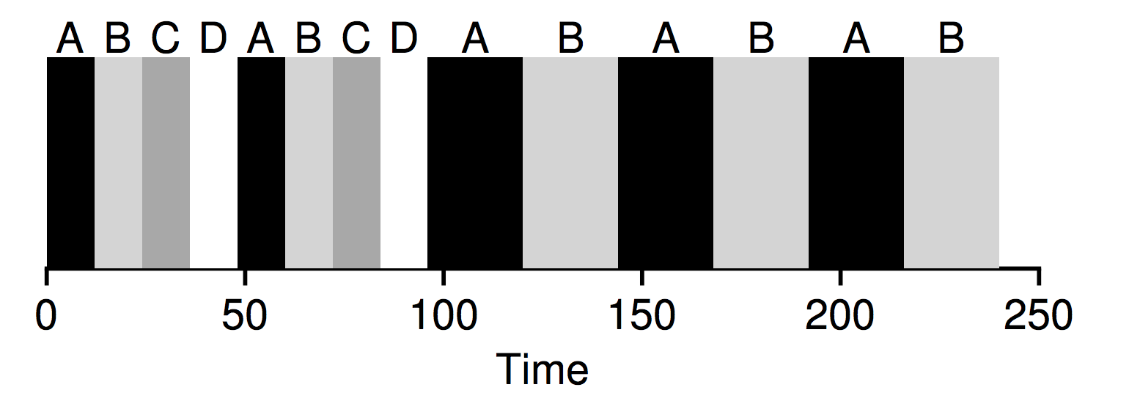
CFS Example
sched_latencey = 48 ms
Four processes that are runnable to start
Per process time slice of 12 ms (48/4)
vruntime is starts at 0 for these jobs
Pick job with the lowest vruntime (A, B, C, or D in this case)
Run job A until it has used 12 ms of vruntime
Then make a scheduling decision
Run the job with the lowest vruntime
(B, C, or D)
C and D complete after 96 ms
Time slice is adjusted to 24 ms (48/2)

Slide 5
Too many processes runnable?
Per process time slice is the sched_latency / runnable processes
A lot of runnable processes could lead to small time slices
Lots of context switches and more overhead
CFS min_granularity parameter
Minimum time slice of a process (e.g., 6 ms)
CFS will never set the time slice of a process to less than this value
In this case, CFS may not be perfectly fair over the target scheduling latency
E.g., sched_latencey = 48 ms with 10 runnable processes
time slice 4.8 --> 6 ms
all jobs won’t run during the 48 ms
Timer interrupts
Time slices are variable, how to set the timer?
Timer goes off frequently (e.g., 1 ms)
Gives the CFS scheduler a chance to see if the current job has reached the end of its run

Slide 6
Niceness Levels
Gives the user control over process priority
Give some processes a higher (or lower) share of the CPU
A nice level of a process
A measure of how nice (to other processes) your job is
19 (lowest priority)
-20 (highest priority)
Nice levels are mapped to a weight used to compute an effective time slice for a process

Slide 7
Niceness Weightings

Slide 8
Niceness Weighting Example
Two processes, A and B
A’s niceness level is -5 (boost in priority)
B’s niceness level is 0 (default)
Calculate the time slice for A and B
Weight A: 3121, weight B: 1024, total weight: 4145
Time slice A: 3121 / 4145 = 0.753 * sched_latency
Time slice B: 1024 / 4145 = 0.247 * sched_latency
Assuming a 48 ms sched_latency:
Process A gets about 75% of the sched_latency (36 ms)
B gets about 25% of the sched_latency (12 ms)
Weight table is constructed to preserve CPU proportionally ratios when the difference in nice values is constant
E.g., if process A had a nice value of 5 and B had a nice value of 10, they would be scheduled the same way as above

Slide 9
Calculating vruntime
Higher priority processes get a longer time slice
But we pick the process with the lowest vruntime to run next
To handle priority properly, vruntime must scale inversely with priority
For our example:
A’s vruntime will accumulate at about a 1/3 the rate of B’s

Slide 10
CFS efficiency
How quickly can the scheduler find the next job to run
Lists don’t scale if you have 1000s of processes to search through ever millisecond
CFS keeps processes in a red-black tree
A type of balanced tree
Does a little extra work to maintain low depths
O(log n) for operations (search, insert, delete)
CFS only keeps running and runnable processes in this structure
If a process is waiting on I/O, it is removed from the tree and kept track elsewhere
What to do when process wakes up?
vruntime will be behind the others and could monopolize the CPU
CFS sets the vruntime for the job to the minimum value found in the tree
Jobs that sleep for short periods often do not ever get their fair share of the CPU

Slide 11
Linux CFS Summary
Linux Completely Fair Scheduler (CFS)
Most widely used fair-share scheduler in existence
A bit like a weighted round-robin with dynamic time slices
Built to scale and perform well under load

