Slide 1
Condition Variables

Slide 2
Condition Variables
There are many cases where we wish to have coordination between threads
A thread wishes to check whether a condition is true before continuing its execution
Example:
  A parent thread might wish to check whether a child thread has completed
  This is often called a join()

Slide 3
Condition Variables Example
A Parent Waiting For Its Child
1 void *child(void *arg) {
2 printf("child\n");
3 // TODO: how to indicate we are done?
4 return NULL;
5 }
6
7 int main(int argc, char *argv[]) {
8 printf("parent: begin\n");
9 pthread_t c;
10 Pthread_create(&c, NULL, child, NULL); // create child
11 // TODO: how to wait for child?
12 printf("parent: end\n");
13 return 0;
14 }
What we would like to see here is:
parent: begin
child
parent: end
Notes:
We know pthread_join() does this, assume we don’t have this function available.

Slide 4
Parent waiting for child: Spin-based Approach
1 volatile int done = 0;
2
3 void *child(void *arg) {
4 printf("child\n");
5 done = 1;
6 return NULL;
7 }
8
9 int main(int argc, char *argv[]) {
10 printf("parent: begin\n");
11 pthread_t c;
12 Pthread_create(&c, NULL, child, NULL); // create child
13 while (done == 0)
14 ; // spin
15 printf("parent: end\n");
16 return 0;
17 }
  This is hugely inefficient as the parent spins and wastes CPU time
  How should a thread wait for a condition?

Slide 5
How to wait for a condition
Condition variable – an object used to wait for some condition to be true
  Waiting on the condition variable
    An explicit queue that threads can put themselves on when some state of execution is not as desired
    The thread is no longer running, freeing up the CPU to run another thread
  Signaling on the condition variable
    Some other thread, when it changes said state, can wake one of those waiting threads and allow them to continue

Slide 6
Pthread Condition Variables
Declare condition variable
  Proper initialization is required
Operation
  The wait() call takes a mutex as a parameter
    The wait() call release the lock and put the calling thread to sleep
    When the thread wakes up, it must re-acquire the lock
    It is assumed the thread is holding the lock with signal() is called
pthread_cond_t c;
pthread_cond_t c = PTHREAD_COND_INITIALIZER; // Declaration and initialization
or
pthread_cond_init(pthread_cond_t *c, pthread_attr_t *attr) // Initialization with attributes
pthread_cond_wait(pthread_cond_t *c, pthread_mutex_t *m); // wait()
pthread_cond_signal(pthread_cond_t *c); // signal()

Slide 7
Parent waiting for Child: Use a condition variable
1 volatile int done = 0;
2 pthread_mutex_t m = PTHREAD_MUTEX_INITIALIZER;
3 pthread_cond_t c = PTHREAD_COND_INITIALIZER;
4
5 void thr_exit() {
6 Pthread_mutex_lock(&m);
7 done = 1;
8 Pthread_cond_signal(&c);
9 Pthread_mutex_unlock(&m);
10 }
11
12 void *child(void *arg) {
13 printf("child\n");
14 thr_exit();
15 return NULL;
16 }
17
18 void thr_join() {
19 Pthread_mutex_lock(&m);
20 while (done == 0)
21 Pthread_cond_wait(&c, &m);
22 Pthread_mutex_unlock(&m);
23 }
25 int main(int argc, char *argv[]) {
26 printf("parent: begin\n");
27 pthread_t p;
28 Pthread_create(&p, NULL, child, NULL);
29 thr_join();
30 printf("parent: end\n");
31 return 0;
32 }

Slide 8
Parent waiting for child using a condition variable
Parent:
  Create the child thread and continues running itself
  Call into thr_join() to wait for the child thread to complete
    Acquire the lock
    Check if the child is done
    Put itself to sleep by calling wait()
    Release the lock
Child:
  Print the message “child”
  Call thr_exit() to wake the parent thread
    Grab the lock
    Set the state variable done
    Signal the parent thus waking it

Slide 9
The Importance of the state variable done
1 void thr_exit() {
2 Pthread_mutex_lock(&m);
3 Pthread_cond_signal(&c);
4 Pthread_mutex_unlock(&m);
5 }
6
7 void thr_join() {
8 Pthread_mutex_lock(&m);
9 Pthread_cond_wait(&c, &m);
10 Pthread_mutex_unlock(&m);
11}
  Can you think of a scenario where we could run into problems?
  Imagine the case where the child runs immediately
    The child will signal, but there is no thread sleeping on the condition
    When the parent runs, it will call wait and be stuck
    No thread will ever wake it, sad panda!
25 int main(int argc, char *argv[]) {
26 printf("parent: begin\n");
27 pthread_t p;
28 Pthread_create(&p, NULL, child, NULL);
29 thr_join();
30 printf("parent: end\n");
31 return 0;
32 }
thr_exit() and thr_join() without variable done

Slide 10
Importance of locks
volitile int done = 0;
3 void thr_exit() {
4 done = 1;
5 Pthread_cond_signal(&c);
6 }
7
8 void thr_join() {
9 if (done == 0)
10 Pthread_cond_wait(&c);
11 }
25 int main(int argc, char *argv[]) {
26 printf("parent: begin\n");
27 pthread_t p;
28 Pthread_create(&p, NULL, child, NULL);
29 thr_join();
30 printf("parent: end\n");
31 return 0;
32 }
  Can you find the bug? (assume you don’t need a lock to use signal and wait)
  The issue here is a race condition
    The parent calls thr_join()
      The parent checks the value of done
      It will see that it is 0 and try to go to sleep
      Just before it calls pthread_cond_wait() to go to sleep, the parent is interrupted, and the child runs
    The child changes the state variable done to 1 and signals
      But no thread is waiting and thus no thread is woken
      When the parent runs again, it sleeps forever, sad!
Notes:
Problem: parent runs and calls join, after the check on done, context switch, child runs, signal is missed in parent b/c it hasn’t called wait yet.

Slide 11
The Producer / Consumer (Bounded Buffer) Problem
Producer
  Produces data items
  Wishes to place data items in a buffer
Consumer
  Grabs data items out of the buffer to consume them in some way
Example: Multi-threaded web server
  A producer puts HTTP requests into a work queue
  Consumer threads take requests out of this queue and process them

Slide 12
Producer/Consumer (non-working)
1 void *producer(void *arg) {
2 int i;
3 int loops = (int) arg;
4 for (i = 0; i < loops; i++) {
5 put(i);
6 }
7 }
8
9 void *consumer(void *arg) {
10 int i;
11 while (1) {
12 int tmp = get();
13 printf("%d\n", tmp);
14 }
15 }
1 int buffer;
2 int count = 0; // initially, empty
3
4 void put(int value) {
5 assert(count == 0);
6 count = 1;
7 buffer = value;
8 }
9
10 int get() {
11 assert(count == 1);
12 count = 0;
13 return buffer;
14 }
  Put -- Only put data into the buffer when count is zero (i.e., when the buffer is empty)
  Get -- Only get data from the buffer when count is one (i.e., when the buffer is full)
  Producer -- puts an integer into the shared buffer loops number of times
  Consumer -- gets the data out of that shared buffer
  Need synchronization between the producer and consumer

Slide 13
Producer/Consumer: Single CV and If Statement
1 cond_t cond;
2 mutex_t mutex;
3
4 void *producer(void *arg) {
5 int i;
6 int loops = (int) arg;
7 for (i = 0; i < loops; i++) {
8 Pthread_mutex_lock(&mutex);
9 if (count == 1) // buffer is full
10 Pthread_cond_wait(&cond, &mutex);
11 put(i);
12 Pthread_cond_signal(&cond);
13 Pthread_mutex_unlock(&mutex);
14 }
15 }
16 void *consumer(void *arg) {
17 int i;
18 for (i = 0; i < loops; i++) {
Pthread_mutex_lock(&mutex);
if (count == 0)
21 Pthread_cond_wait(&cond, &mutex);
22 int tmp = get();
23 Pthread_cond_signal(&cond);
24 Pthread_mutex_unlock(&mutex);
25 printf("%d\n", tmp);
26 }
27 }
A single condition variable cond and associated lock mutex
  Works if there is one producer and one consumer
What happens if that is not the case (e.g., 2 consumers, 1 producer)?
  C1 runs and waits, P1 puts an item in and signals C1
  Before C1 gets to run, C2 sneaks in and consumes the item, setting count to 0
  When C1 runs, no more items left, sad!
  Recheck state (in a while loop) upon returning from wait!

Slide 14
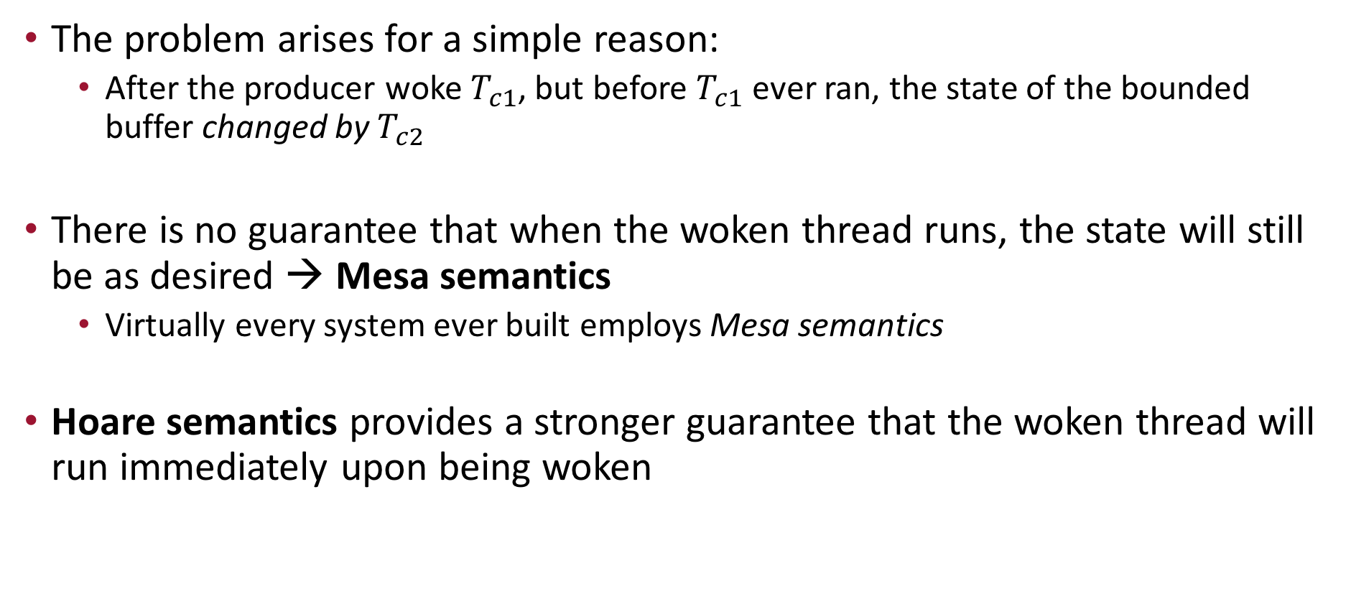
Thread Trace: Broken Solution
The problem arises for a simple reason:
  After the producer woke $T_{c1}$, but before $T_{c1}$ ever ran, the state of the bounded buffer changed by $T_{c2}$
There is no guarantee that when the woken thread runs, the state will still be as desired → Mesa semantics
  Virtually every system ever built employs Mesa semantics
Hoare semantics provides a stronger guarantee that the woken thread will run immediately upon being woken

Slide 15
Producer/Consumer: Single CV and While
1 cond_t cond;
2 mutex_t mutex;
3
4 void *producer(void *arg) {
int i;
int loops = (int) arg;
7 for (i = 0; i < loops; i++) {
8 Pthread_mutex_lock(&mutex);
9 while (count == 1)
10 Pthread_cond_wait(&cond, &mutex);
11 put(i);
12 Pthread_cond_signal(&cond);
13 Pthread_mutex_unlock(&mutex);
14 }
15 }
16 void *consumer(void *arg) {
17 int i;
18 for (i = 0; i < loops; i++) {
Pthread_mutex_lock(&mutex);
while (count == 0)
21 Pthread_cond_wait(&cond, &mutex);
22 int tmp = get();
23 Pthread_cond_signal(&cond);
24 Pthread_mutex_unlock(&mutex);
25 printf("%d\n", tmp);
26 }
27 }
This fixes our previous problem, however, this code still has a bug
  Assume two consumers and one producer
  C1 runs, finds the buffer empty and waits, C2 runs, finds the buffer empty and waits
  P1 runs, produces an item, signals, and waits because buffer is full
  C1 wakes (from P1 signal) and consumes the buffer, signals, and then waits
    Who gets the signal, P1 or C2?
  C2 wakes, finds the buffer empty and waits – everyone is sleeping, sad!

Slide 16
The single Buffer Producer/Consumer Solution
Use two condition variables and while loops
  Producer threads wait on the condition empty, and signals fill
  Consumer threads wait on fill and signal empty
1 cond_t empty, fill;
2 mutex_t mutex;
3
4 void *producer(void *arg) {
int i;
int loops = (int) arg;
7 for (i = 0; i < loops; i++) {
8 Pthread_mutex_lock(&mutex);
9 while (count == 1)
10 Pthread_cond_wait(&empty, &mutex);
11 put(i);
12 Pthread_cond_signal(&fill);
13 Pthread_mutex_unlock(&mutex);
14 }
15 }
16 void *consumer(void *arg) {
17 int i;
18 for (i = 0; i < loops; i++) {
19 Pthread_mutex_lock(&mutex);
20 while (count == 0)
21 Pthread_cond_wait(&fill, &mutex);
22 int tmp = get();
23 Pthread_cond_signal(&empty);
24 Pthread_mutex_unlock(&mutex);
25 printf("%d\n", tmp);
26 }
27 }

Slide 17

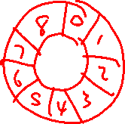
The Final Producer/Consumer Solution
1 cond_t empty, fill;
2 mutex_t mutex;
3
4 void *producer(void *arg) {
for (int i = 0; i < loops; i++) {
int loops = (int) arg;
8 Pthread_mutex_lock(&mutex);
9 while (count == MAX)
10 Pthread_cond_wait(&empty, &mutex);
11 put(i);
12 Pthread_cond_signal(&fill);
13 Pthread_mutex_unlock(&mutex);
14 }
15 }
16
17 void *consumer(void *arg) {
18 for (int i = 0; i < loops; i++) {
19 Pthread_mutex_lock(&mutex);
20 while (count == 0)
21 Pthread_cond_wait(&fill, &mutex);
int tmp = get();
Pthread_cond_signal(&empty);
Pthread_mutex_unlock(&mutex);
printf("%d\n", tmp);
}
}
More concurrency and efficiency
  Add more buffer slots
  Allow concurrent production or consuming to take place
  Reduce context switches
1 int buffer[MAX];
2 int fill = 0;
3 int use = 0;
4 int count = 0;
5
6 void put(int value) {
7 buffer[fill] = value;
8 fill = (fill + 1) % MAX;
9 count++;
10 }
11
12 int get() {
13 int tmp = buffer[use];
14 use = (use + 1) % MAX;
15 count--;
16 return tmp;
17 }
Notes:
Draw a diagram of a circular buffer.

Slide 18
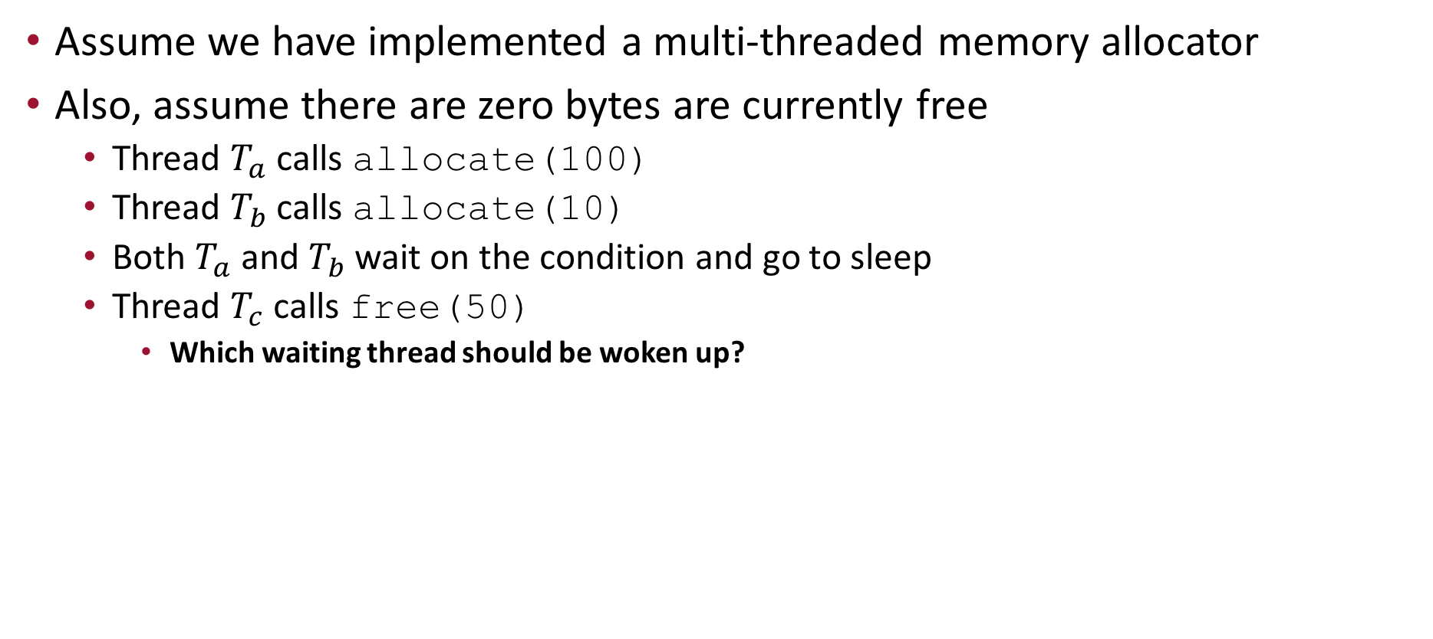
Covering Conditions
Assume we have implemented a multi-threaded memory allocator
Also, assume there are zero bytes are currently free
  Thread $T_{a}$ calls allocate(100)
  Thread $T_{b}$ calls allocate(10)
  Both $T_{a}$ and $T_{b}$ wait on the condition and go to sleep
  Thread $T_{c}$ calls free(50)
    Which waiting thread should be woken up?

Slide 19
Covering Conditions Example Code
1 // how many bytes of the heap are free?
2 int bytesLeft = MAX_HEAP_SIZE;
3
4 // need lock and condition too
5 cond_t c;
6 mutex_t m;
7
8 void *
9 allocate(int size) {
10 Pthread_mutex_lock(&m);
11 while (bytesLeft < size)
12 Pthread_cond_wait(&c, &m);
13 void *ptr = ...; // get mem from heap
14 bytesLeft -= size;
15 Pthread_mutex_unlock(&m);
16 return ptr;
17 }
18
19 void free(void *ptr, int size) {
20 Pthread_mutex_lock(&m);
21 bytesLeft += size;
22 Pthread_cond_signal(&c); // who do we signal??
23 Pthread_mutex_unlock(&m);
24 }

Slide 20
Covering Conditions Solution
Solution:
  Replace pthread_cond_signal() with pthread_cond_broadcast()
  pthread_cond_broadcast()
    Wake up all waiting threads
    Cost: too many threads might be woken up
    Threads that shouldn’t be woken up will simply wake up, re-check the condition, and then go back to sleep

Slide 21
Covering Conditions Solution Code
1 // how many bytes of the heap are free?
2 int bytesLeft = MAX_HEAP_SIZE;
3
4 // need lock and condition too
5 cond_t c;
6 mutex_t m;
7
8 void *
9 allocate(int size) {
10 Pthread_mutex_lock(&m);
11 while (bytesLeft < size)
12 Pthread_cond_wait(&c, &m);
13 void *ptr = ...; // get mem from heap
14 bytesLeft -= size;
15 Pthread_mutex_unlock(&m);
16 return ptr;
17 }
18
19 void free(void *ptr, int size) {
20 Pthread_mutex_lock(&m);
21 bytesLeft += size;
22 Pthread_cond_broadcast(&c); // wake up all the threads waiting
23 Pthread_mutex_unlock(&m);
24 }

Slide 22
Condition Variable Summary
We have a new synchronization primitive beyond locks
  Condition variables
Allows for a thread to sleep when some program state is not as desired
  Once sleeping, another thread must wake up the thread by signal/broadcast
Condition variables are used in conjunction with a lock
  When waiting on the CV, the lock is (temporarily) given up
  While returning from the wait, the thread re-acquires the lock
When a thread is signaled, it may not wake up right away
  The state of the world may have changed
  Recheck your state (in a while loop) upon returning from wait if there is any chance the state may have changed

