Slide 1
Common Concurrency Problems (When Good Threads go Bad)

Slide 2
Common Concurrency Problems
We’ve briefly talked about deadlock
Lots of early research focused on this
We’ll dive in a bit more deeply today
What other concurrency problems exist?
Look at some example concurrency problems found in real code bases

Slide 3
What Types Of Bugs Exist?
Focus on four major open-source applications
MySQL, Apache, Mozilla, OpenOffice
Non-deadlock bugs make up a majority of concurrency bugs
Two major types of non deadlock bugs
Atomicity violation
Order violation
Application | What it does | Non-Deadlock | Deadlock
MySQL | Database Server | 14 | 9
Apache | Web Server | 13 | 4
Mozilla | Web Browser | 41 | 16
Open Office | Office Suite | 6 | 2
Total |  | 74 | 31
Bugs In Modern Applications

Slide 4
Atomicity-Violation Bugs
The desired serializability among multiple memory accesses is violated
Simple Example found in MySQL:
Two different threads access the field proc_info in the struct thd
1 Thread1::
2 if(thd->proc_info){
3 …
4 fputs(thd->proc_info , …);
5 …
6 }
7
8 Thread2::
9 thd->proc_info = NULL;

Slide 5
Atomicity-Violation Bugs (Cont.)
Solution: Simply add locks around the shared-variable references
pthread_mutex_t lock = PTHREAD_MUTEX_INITIALIZER;
Thread1::
pthread_mutex_lock(&lock);
if(thd->proc_info){
…
fputs(thd->proc_info , …);
…
}
pthread_mutex_unlock(&lock);
Thread2::
pthread_mutex_lock(&lock);
thd->proc_info = NULL;
pthread_mutex_unlock(&lock);

Slide 6
Order-Violation Bugs
The desired order between two memory accesses is flipped
I.e., A should always be executed before B, but the order is not enforced during execution
Example:
The code in Thread2 seems to assume that the variable mThread has already been initialized (and is not NULL)
Thread1::
void init(){
mThread = PR_CreateThread(mMain, …);
}
Thread2::
void mMain(…){
mState = mThread->State
}

Slide 7
Order-Violation Bugs (Cont.)
Solution: enforce ordering using condition variables
pthread_mutex_t mtLock = PTHREAD_MUTEX_INITIALIZER;
pthread_cond_t mtCond = PTHREAD_COND_INITIALIZER;
int mtInit = 0;
Thread 1::
void init(){
…
mThread = PR_CreateThread(mMain,…);
// signal that the thread has been created.
pthread_mutex_lock(&mtLock);
mtInit = 1;
pthread_cond_signal(&mtCond);
pthread_mutex_unlock(&mtLock);
…
}
Thread2::
void mMain(…){
// wait for the thread to be initialized …
pthread_mutex_lock(&mtLock);
while(mtInit == 0)
pthread_cond_wait(&mtCond, &mtLock);
pthread_mutex_unlock(&mtLock);
mState = mThread->State;
…
}

Slide 8
Deadlock Bugs
The presence of a cycle in a resource-allocation graph
Thread1 is holding a lock L1 and waiting for another one, L2.
Thread2 that holds lock L2 is waiting for L1 to be release.
Thread 1: lock(L1); lock(L2); | Thread 2: lock(L2); lock(L1);
Thread 1
Holds
Lock L1
Wanted by
Wanted by
Lock L2
Thread 2
Holds

Slide 9
Why Do Deadlocks Occur?
Reason 1:
In large code bases, complex dependencies arise between components
Reason 2:
Due to the nature of encapsulation
Hide details of implementations and make software easier to build in a modular way
Such modularity does not mesh well with locking

Slide 10
Why Do Deadlocks Occur? (Cont.)
Example: Java Vector class and the method AddAll()
Locks for both the vector being added to (v1) and the parameter (v2) need to be acquired
The routine acquires said locks in some arbitrary order (v1 then v2)
If some other thread calls v2.AddAll(v1) at nearly the same time → We have the potential for deadlock
Vector v1,v2;
v1.AddAll(v2);

Slide 11
Conditional for Deadlock
Four conditions need to hold for a deadlock to occur
If any of these four conditions are not met, deadlock cannot occur
Condition | Description
Mutual Exclusion | Threads claim exclusive control of resources that they require
Hold-and-wait | Threads hold resources allocated to them while waiting for additional resources
No preemption | Resources cannot be forcibly removed from threads that are holding them
Circular wait | There exists a circular chain of threads such that each thread holds one more resources that are being requested by the next thread in the chain

Slide 12
Deadlock vs. Starvation
Deadlock: A circular waiting for resources
Starvation: A thread never makes progress because other threads are using resources it needs
Starvation != Deadlock
Deadlock can be seen as a special case of starvation

Slide 13
Methods for Handling Deadlocks
Ensure that the system will never enter a deadlock state:
Deadlock prevention – deadlock is not possible in the system
Deadlock avoidance – prevent a particular instance of deadlock from happening
Allow the system to enter a deadlock state and then recover
Ignore the problem and pretend that deadlocks never occur in the system
Used by most operating systems, including UNIX

Slide 14
Deadlock Prevention
Restrain the ways requests can be made to make at least one of the four deadlock conditions does not hold
Mutual Exclusion – not required for sharable resources (e.g., read-only files); must hold for non-sharable resources
Hold and Wait – must guarantee that whenever a process requests a resource, it does not hold any other resources
Require process to request and be allocated all its resources before it begins execution, or allow process to request resources only when the process has none allocated to it.
Low resource utilization; starvation possible

Slide 15
Deadlock Prevention (Cont.)
No Preemption –
If a process that is holding some resources requests another resource that cannot be immediately allocated to it, then all resources currently being held are released
Preempted resources are added to the list of resources for which the process is waiting
Process will be restarted only when it can regain its old resources, as well as the new ones that it is requesting
Circular Wait – impose a total ordering of all resource types, and require that each process requests resources in an increasing order of enumeration

Slide 16
Deadlock Avoidance
Requires that the system has some additional a priori information available
Simplest and most useful model requires that each process declare the maximum number of resources of each type that it may need
The deadlock-avoidance algorithm dynamically examines the resource-allocation state to ensure that there can never be a circular-wait condition
Resource-allocation state is defined by the number of available and allocated resources, and the maximum demands of the processes

Slide 17
Safe State
When a process requests an available resource, system must decide if immediate allocation leaves the system in a safe state
System is in safe state if there exists a safe sequence <P₁, P₂, …, P_{n}> of ALL the processes in the systems such that for each P_{i}, the resources that P_{i} can still request can be satisfied by currently available resources + resources held by all the P_{j}, with j < i
That is:
If P_{i} resource needs are not immediately available, then P_{i} can wait until all P_{j} have finished
When P_{j} is finished, P_{i} can obtain needed resources, execute, return allocated resources, and terminate
When P_{i} terminates, P_{i +1} can obtain its needed resources, and so on

Slide 18
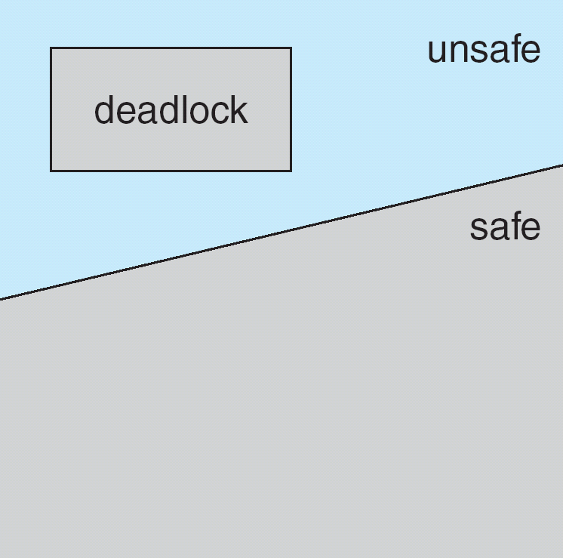
Basic Facts
If a system is in safe state ⇒ no deadlocks
If a system is in unsafe state ⇒ possibility of deadlock
Avoidance ⇒ ensure that a system will never enter an unsafe state.

Slide 19
Avoidance Algorithms
Single instance of a resource type
Use a resource-allocation graph
Check for cycles
Multiple instances of a resource type
Use the banker’s algorithm

Slide 20
Resource-Allocation Graph
We have a set of vertices V and a set of edges E
V is partitioned into two types:
P = {P₁, P₂, …, P_{n}}, the set consisting of all the processes in the system
R = {R₁, R₂, …, R_{m}}, the set consisting of all resource types in the system
request edge – directed edge P_{i} → R_{j}
assignment edge – directed edge R_{j} → P_{i}

Slide 21
Resource-Allocation Graph (Cont.)
Process
Resource Type with 4 instances
P_{i} requests instance of R_{j}
P_{i} is holding an instance of R_{j}
P_{i}
R_{j}
P_{i}
R_{j}

Slide 22
Example of a Resource Allocation Graph
Notes:
Do we have deadlock? No, P3 will eventually terminate and free R3 for P2

Slide 23
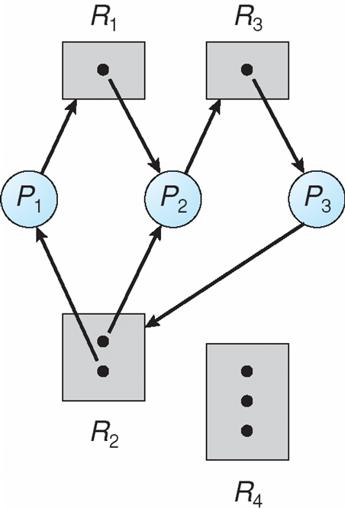
Resource Allocation Graph With A Deadlock

Slide 24
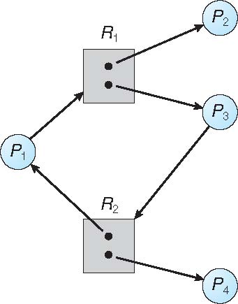
Graph With A Cycle But No Deadlock
Notes:
Key distinction, Two instances of R2. If there were only one instance, it would mean deadlock.

Slide 25
Basic Facts
If graph contains no cycles ⇒ no deadlock
If graph contains a cycle ⇒
if only one instance per resource type, then deadlock
if several instances per resource type, possibility of deadlock

Slide 26
Avoidance Algorithms
Single instance of a resource type
Use a resource-allocation graph
Check for cycles
Multiple instances of a resource type
Use the banker’s algorithm

Slide 27
Banker’s Algorithm
Have multiple instances of resources
Each process must a priori claim maximum resource use (not to exceed total resources in the system)
When a process requests a resource it may have to wait
When a process gets all its resources it must return them in a finite amount of time
Notes:
The name was chosen because the algorithm could be used in a banking system so that a bank never allocated its available cash in such a way that it could no longer satisfy the needs of all its customers.

Slide 28
Deadlock Detection
Allow system to enter deadlock state
Detect that deadlock has occurred
Detection algorithm
Recover from deadlock
Recovery scheme

Slide 29
Single Instance of Each Resource Type
Maintain wait-for graph
Nodes are processes
P_{i} → P_{j} if P_{i} is waiting for P_{j}
Periodically invoke an algorithm that searches for a cycle in the graph
If there is a cycle, deadlock exists
An algorithm to detect a cycle in a graph requires an order of n² operations, where n is the number of vertices in the graph

Slide 30
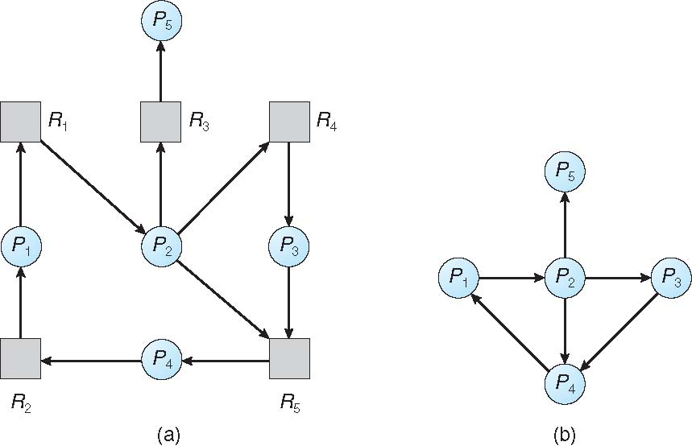
Resource-Allocation Graph and Wait-for Graph
Resource-Allocation Graph
Corresponding wait-for graph

Slide 31
Recovery from Deadlock: Process Termination
Abort all deadlocked processes
Abort one process at a time until the deadlock cycle is eliminated
In which order should we choose to abort?
Priority of the process
How long process has computed, and how much longer to completion
Resources the process has used
Resources process needs to complete
How many processes will need to be terminated
Is process interactive or batch?

Slide 32
Recovery from Deadlock: Resource Preemption
Selecting a victim – minimize cost
Rollback – return to some safe state, restart process for that state
Starvation – same process may always be picked as victim, include number of rollbacks in cost factor

Slide 33
Summary
Non-deadlock bugs are common
Atomicity violations
Order violations
Often easy to fix (once discovered)
Deadlock
Why it occurs
What can be done about it
Can schedule to avoid deadlock (Banker’s Algorithm)
Assumes we know maximum resources used a priori
Most practical: develop a lock acquisition order which will prevent deadlock from occurring

Slide 34
Example of Banker’s Algorithm
5 processes P₀ through P₄;
3 resource types:
A (10 instances), B (5instances), and C (7 instances)
Snapshot at time T₀:
Allocation Max Need
P₀ A B C A B C A B C
P₀ 0 1 0 7 5 3 7 4 3
P₁ 2 0 0 3 2 2 1 2 2
P₂ 3 0 2 9 0 2 6 0 0
P₃ 2 1 1 2 2 2 0 1 1
P₄ 0 0 2 4 3 3 4 3 1
Available
A B C
3 3 2

Slide 35
System Safety
Is this system safe?
Yes if there is there an ordering of processes that allows all processes to get the recourses they need
Allocation Max Need
P₀ A B C A B C A B C
P₀ 0 1 0 7 5 3 7 4 3
P₁ 2 0 0 3 2 2 1 2 2
P₂ 3 0 2 9 0 2 6 0 0
P₃ 2 1 1 2 2 2 0 1 1
P₄ 0 0 2 4 3 3 4 3 1
Available
A B C
3 3 2
Notes:
First, find a process that can run in with the available resources.
P1 -- 5 3 2
P3 -- 7 4 3
P0 -- 7 5 3
P2 – 10 5 5
P4 --

Slide 36
Data Structures for the Banker’s Algorithm
Let n = number of processes, and m = number of resources
Available – Resources currently available in the system
Vector of length m
If Available [j] = k, there are k instances of resource type R_{j} available
Max – Maximum resources processes may request in the system
n x m matrix
If Max [i,j] = k, then process P_{i} may request at most k instances of resource type R_{j}
Allocation – Resources allocated to processes
n x m matrix
If Allocation[i,j] = k then P_{i} is currently allocated k instances of R_{j}
Need – Resources currently needed by processes
n x m matrix
If Need[i,j] = k, then P_{i} may need k more instances of R_{j} to complete its task
Need [i,j] = Max[i,j] – Allocation [i,j]

Slide 37
Safety Algorithm
1. Let Work and Finish be vectors of length m and n, respectively. Initialize:
Work = Available
Finish [i] = false for i = 0, 1, …, n- 1
2. Find an i such that both:
(a) Finish [i] = false
(b) Need_{i} ≤ Work
If no such i exists, go to step 4
3. Work = Work + Allocation_{i} Finish[i] = true go to step 2
4. If Finish [i] == true for all i, then the system is in a safe state
Notes:
Work = Total working set of resources
m = resources
n = processes
Need_{i} = Row i in the Need_{ij} matrix

Slide 38
Example: P₁ Request (1,0,2)
Check that Request ≤ Available (that is, (1,0,2) ≤ (3,3,2) ⇒ true)
Allocation Need
P₀ A B C A B C
P₀ 0 1 0 7 4 3
P₁ 2 0 0 1 2 2
P₂ 3 0 2 6 0 0
P₃ 2 1 1 0 1 1
P₄ 0 0 2 4 3 1
Available
A B C
3 3 2

Slide 39
Example: P₁ Request (1,0,2)
Check that Request ≤ Available (that is, (1,0,2) ≤ (3,3,2) ⇒ true)
Allocation Need
A B C A B C
P₀ 0 1 0 7 4 3
P₁ 3 0 2 0 2 0
P₂ 3 0 2 6 0 0
P₃ 2 1 1 0 1 1
P₄ 0 0 2 4 3 1
If we grant the request, is the system still in a safe state?
Executing safety algorithm shows that sequence < P₁, P₃, P₄, P₀, P₂> satisfies safety requirement
Can request for (3,3,0) by P₄ now be granted?
No, the request is more than what is available
Can request for (0,2,0) by P₀ now be granted?
No, if that request was granted, no process would be able to finish
Available
A B C
2 3 0
Notes:
p1, p3, p4, p0, p2
No
No

Slide 40
Resource-Request Algorithm for Process P_{i}
Request_{i} = request vector for process P_{i}
If Request_{i} [j] = k then process P_{i} wants k instances of resource type R_{j}
1. If Request_{i} ≤ Need_{i} go to step 2. Otherwise, raise error condition, since process has exceeded its maximum claim
2. If Request_{i} ≤ Available, go to step 3. Otherwise P_{i} must wait, since resources are not available
3. Pretend to allocate requested resources to P_{i} by modifying the state as follows:
Available = Available – Request_{i};
Allocation_{i} = Allocation_{i} + Request_{i};
Need_{i} = Need_{i} – Request_{i};
If safe ⇒ the resources are allocated to P_{i}
If unsafe ⇒ P_{i} must wait, and the old resource-allocation state is restored

