Slide 1
I/O Devices and Disks

Slide 2
I/O Devices
Input and output (I/O) is critical part of computer systems
Issues:
How should I/O be integrated into systems?
What are the general mechanisms?
How can we make I/O efficient?

Slide 3
Structure of input/output (I/O) device
CPU
Memory
Memory Bus
(proprietary)
General I/O Bus
(e.g., PCI)
Graphics
Peripheral I/O Bus
(e.g., SCSI, SATA, USB)
Prototypical System Architecture
CPU is attached to the main memory of the system via a memory bus
Some devices are connected to the system via a general I/O bus
Notes:
Why do we have different busses? Physics and cost. The slower a bus is, the longer and cheaper it can be made.

Slide 4
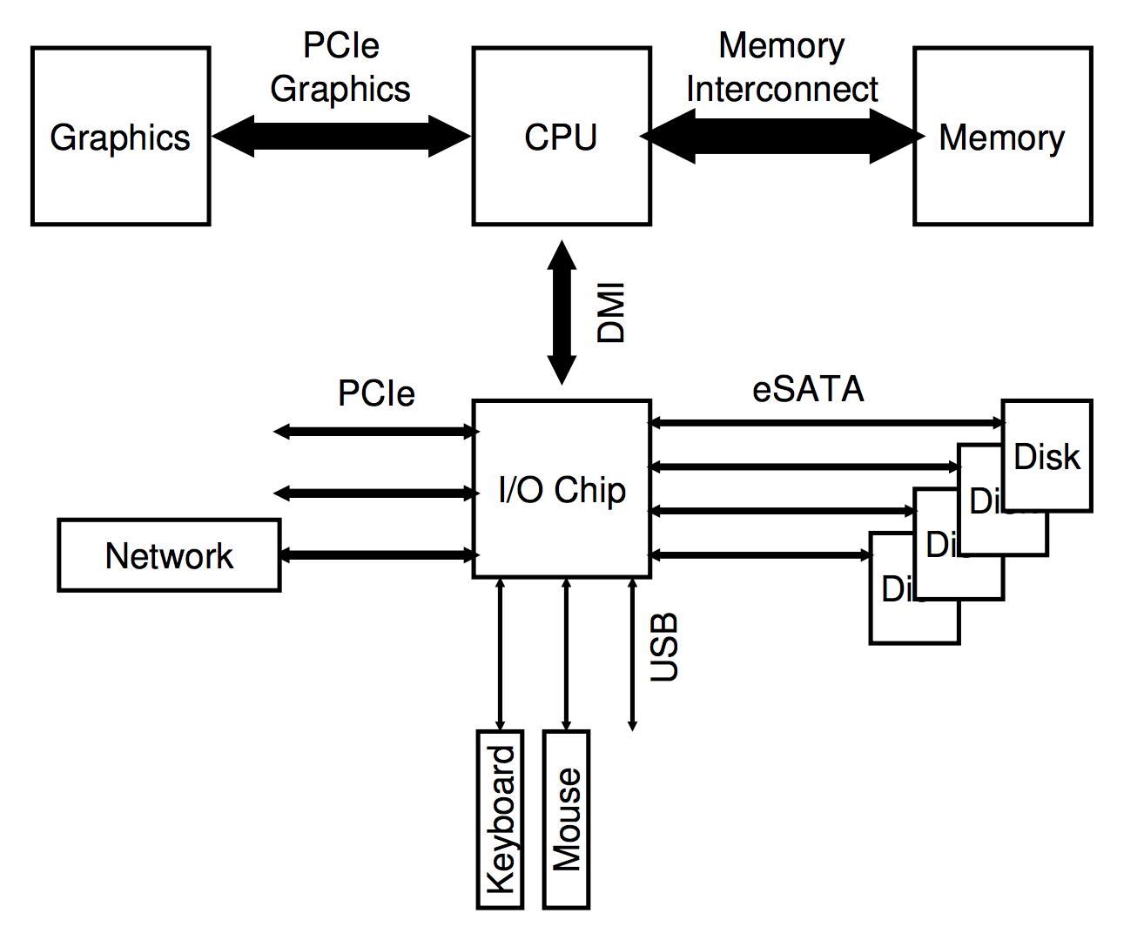
I/O Architecture
Buses
Data paths that provided to enable information between CPU(s), RAM, and I/O devices
I/O bus
Data path that connects a CPU to an I/O device
I/O bus is connected to I/O device by three hardware components:
I/O ports
Interfaces
Device controllers
Notes:
DMI is direct media interface https://en.wikipedia.org/wiki/Direct_Media_Interface Intel's proprietary link between the northbridge and southbridge.

Slide 5
Canonical Device
CPU
Memory
Memory Bus
Canonical Devices has two important components
Hardware interface allows the system software to control its operation
Internals which is implementation specific
Registers
status register
See the current status of the device
command register
Tell the device to perform a certain task
data register
Pass data to the device, or get data from the device
These registers are typically only a few bytes wide
By reading and writing these registers, the OS can control device behavior
General I/O Bus
Graphics
Peripheral I/O Bus
interface
Registers:
Status
Command
Data
Micro-controller(CPU)
Memory (DRAM or SRAM or both)
Other Hardware-specific Chips
internals
Canonical Device

Slide 6
The Canonical Protocol
Example of programmed I/O (PIO)
CPU is involved with the data movement
Operating system waits until the device is ready by repeatedly reading the status register
Simple and correct
Wastes CPU time just waiting for the device
Switching to another ready process would utilize the CPU more
While ( STATUS == BUSY)
; //wait until device is not busy
Write data to DATA register
Write command to COMMAND register
Doing so starts the device and executes the command
While ( STATUS == BUSY)
; //wait until device is done with your request
1
P
“waiting IO”
: task 1
: polling
CPU
.1 | 1 | 1 | 1 | 1 | p | p | p | p | p | 1 | 1 | 1 | 1 | 1
Disk
1 | 1 | 1 | 1 | 1
Diagram of CPU utilization by polling

Slide 7
Interrupts
Put the I/O request process to sleep and context switch to another
When the device is finished, wake the process waiting for the I/O by interrupt
Allows for the CPU and the disk to be properly utilized
1
2
: task 1
: task 2
CPU
1 | 1 | 1 | 1 | 1 | 2 | 2 | 2 | 2 | 2 | 1 | 1 | 1 | 1 | 1
Disk
1 | 1 | 1 | 1 | 1
Diagram of CPU utilization by interrupt

Slide 8
Polling vs. interrupts
Interrupts are not always the best solution
If a device performs very quickly interrupts slow down the system
Context switches are expensive
If a device is fast, polling is preferred
If the device is slow, interrupts are better

Slide 9
Data movement with PIO
The CPU wastes time copying data from memory to the device
CPU copies one word at a time to the device
After data is copied to the device, then it can be written to disk
1
2
Data copy one word at a time
: task 1
: task 2
C
: copy data from memory
CPU
1 | 1 | 1 | 1 | C | C | C | 2 | 2 | 2 | 2 | 2 | 1 | 1 | 1
Disk
1 | 1 | 1 | 1 | 1
Diagram of CPU utilization

Slide 10
DMA (Direct Memory Access)
Copy data in memory by knowing “where the data lives in memory, how much data to copy”
When completed, DMA raises an interrupt, I/O begins on Disk
Transfers between devices and main memory without much CPU intervention
1
2
: task 1
: task 2
C
: copy data from memory
CPU
1 | 1 | 1 | 1 | 2 | 2 | 2 | 2 | 2 | 2 | 2 | 2 | 1 | 1 | 1
DMA
C | C | C
Disk
1 | 1 | 1 | 1 | 1
Diagram of CPU utilization by DMA
Notes:
Future: add DMA diagram.

Slide 11
Device interaction
Two main ways to communicate with devices
I/O instructions: a way for the OS to send data to specific device registers
E.g., in and out instructions on x86
Typically, this a privileged instruction – why?
Memory-mapped I/O
Device registers available as if they were memory locations
The OS loads (to read) or stores (to write) to the device instead of main memory
No new instructions, same as a memory read or write

Slide 12
The OS interface: the device driver
How does the OS interact with different specific hardware interfaces?
E.g., we would like to build a single file system interface that works with:
SCSI disks
SATA disks
USB disks and so on
Abstraction encapsulates any specifics of device interaction
At the lowest level, the OS must know how the hardware works
We call this software a device driver
Provides a higher-level interface to the rest of the system

Slide 13
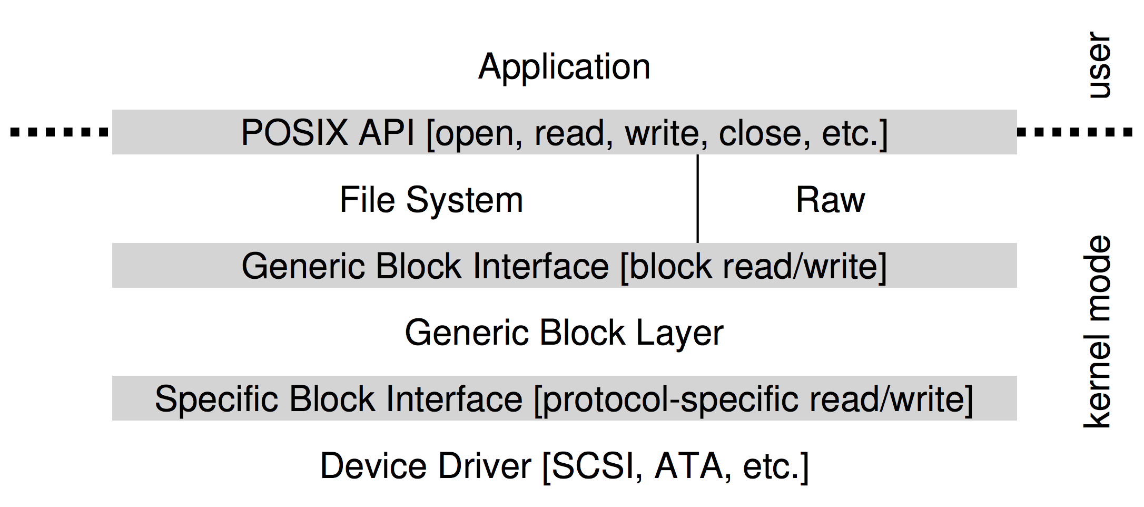
Example Driver: File system Abstraction
Application is unaware of the type of filesystem
File system is unaware of which type of disk it is using
Issues block read/write requests to a generic block layer
Many drivers expose a raw interface to allow for special applications

Slide 14
Problems With Device Driver Abstraction
If there is a device with special capabilities, these capabilities will go unused in the generic interface layer
Over 70% of Linux code is found in device drivers
Need a device driver for any piece of hardware you might plug into your system
Often not written by full-time kernel developers
Especially true for non commodity hardware
They are primary contributor to kernel crashes!

Slide 15
A Simple IDE Disk Driver: Registers
Control Register:
Address 0x3F6: set to enable interrupts
Command Block Registers:
Address 0x1F0: Data Port
Address 0x1F1: Error
Address 0x1F2: Sector Count
Address 0x1F3: LBA low byte
Address 0x1F4: LBA mid byte
Address 0x1F5: LBA hi byte
Address 0x1F6: 1B1D TOP4LBA: B=LBA, D=drive
Address 0x1F7 = Command/status
Status Register (Address 0x1F7):
7 6 5 4 3 2 1 0
BUSY READY FAULT SEEK DRQ CORR IDDEX ERROR
Error Register (Address 0x1F1): (check when Status ERROR==1)
7 6 5 4 3 2 1 0
BBK UNC MC IDNF MCR ABRT T0NF AMNF
BBK = Bad Block
UNC = Uncorrectable data error
MC = Media Changed
IDNF = ID mark Not Found
MCR = Media Change Requested
ABRT = Command aborted
T0NF = Track 0 Not Found
AMNF = Address Mark Not Found

Slide 16
Basic IDE Protocol
Wait for drive to be ready
Read Status Register (0x1F7) until drive is not BUSY and READY
Write parameters to command registers
Write the sector count, logical block address (LBA) of the sectors to be accessed, and drive number to command registers (0x1F2-0x1F6)
Start the I/O
Write the READ/WRITE command to command register (0x1F7)
Data transfer (for writes)
Wait until drive status is READY and DRQ (drive request for data)
Write data to data port
Handle interrupts
In the simplest case, handle an interrupt for each sector transferred
DMA allows for batching and a final interrupt when the entire transfer is complete
Error handling
After each operation, read the status register
If the ERROR bit is on, read the error register for details

Slide 17
I/O Summary
For efficiency we use:
Interrupts: allow process to sleep while slow I/O takes place
DMA: Allow transfer between memory and a device with little CPU intervention
Accessing Hardware
Explicit I/O instructions (inb outb)
Memory mapped I/O (register access looks like a memory read or write)
Drivers
Encapsulate low-level details of the hardware
Makes it easier to build the rest of the OS in a device-neutral fashion

Slide 18
Hard Disk Drives
Hard disk drives have been the main form of persistent data storage in computer systems for decades
The drive consists of many sectors (e.g., 512-byte blocks)
Arranged in circular tracks around the disk
The only guarantee is that a single 512-byte write is atomic
Address Space
We can view a disk with n sectors as an array of sectors, 0 to n-1
Multi-sector operations are possible
Many file systems will read or write 4KB at a time (common page size)
Torn write
If an untimely power loss or error occurs, only a portion of a larger write may complete
Accessing blocks in a contiguous chunk is the fastest access mode
A sequential read or write
Much faster than a more random access pattern

Slide 19
Basic Geometry
Platters (one of the best musical groups ever!)
Only You
The Great Pretender
Smoke Gets In Your Eyes
And more!
Spindle
Spindle is connected to a motor that spins the platters around
The rate of rotations is measured in RPM (Rotations Per Minute)
Typical modern values : 7,200 RPM to 15,000 RPM
E.g., 10000 RPM : A single rotation takes about 6 ms
Track
Concentric circles of sectors
Data is encoded on each surface in a track
A single surface contains many thousands and thousands of tracks
spindle
A Disk with Just A Single Track (Smoke Gets In Your Eyes)

Slide 20
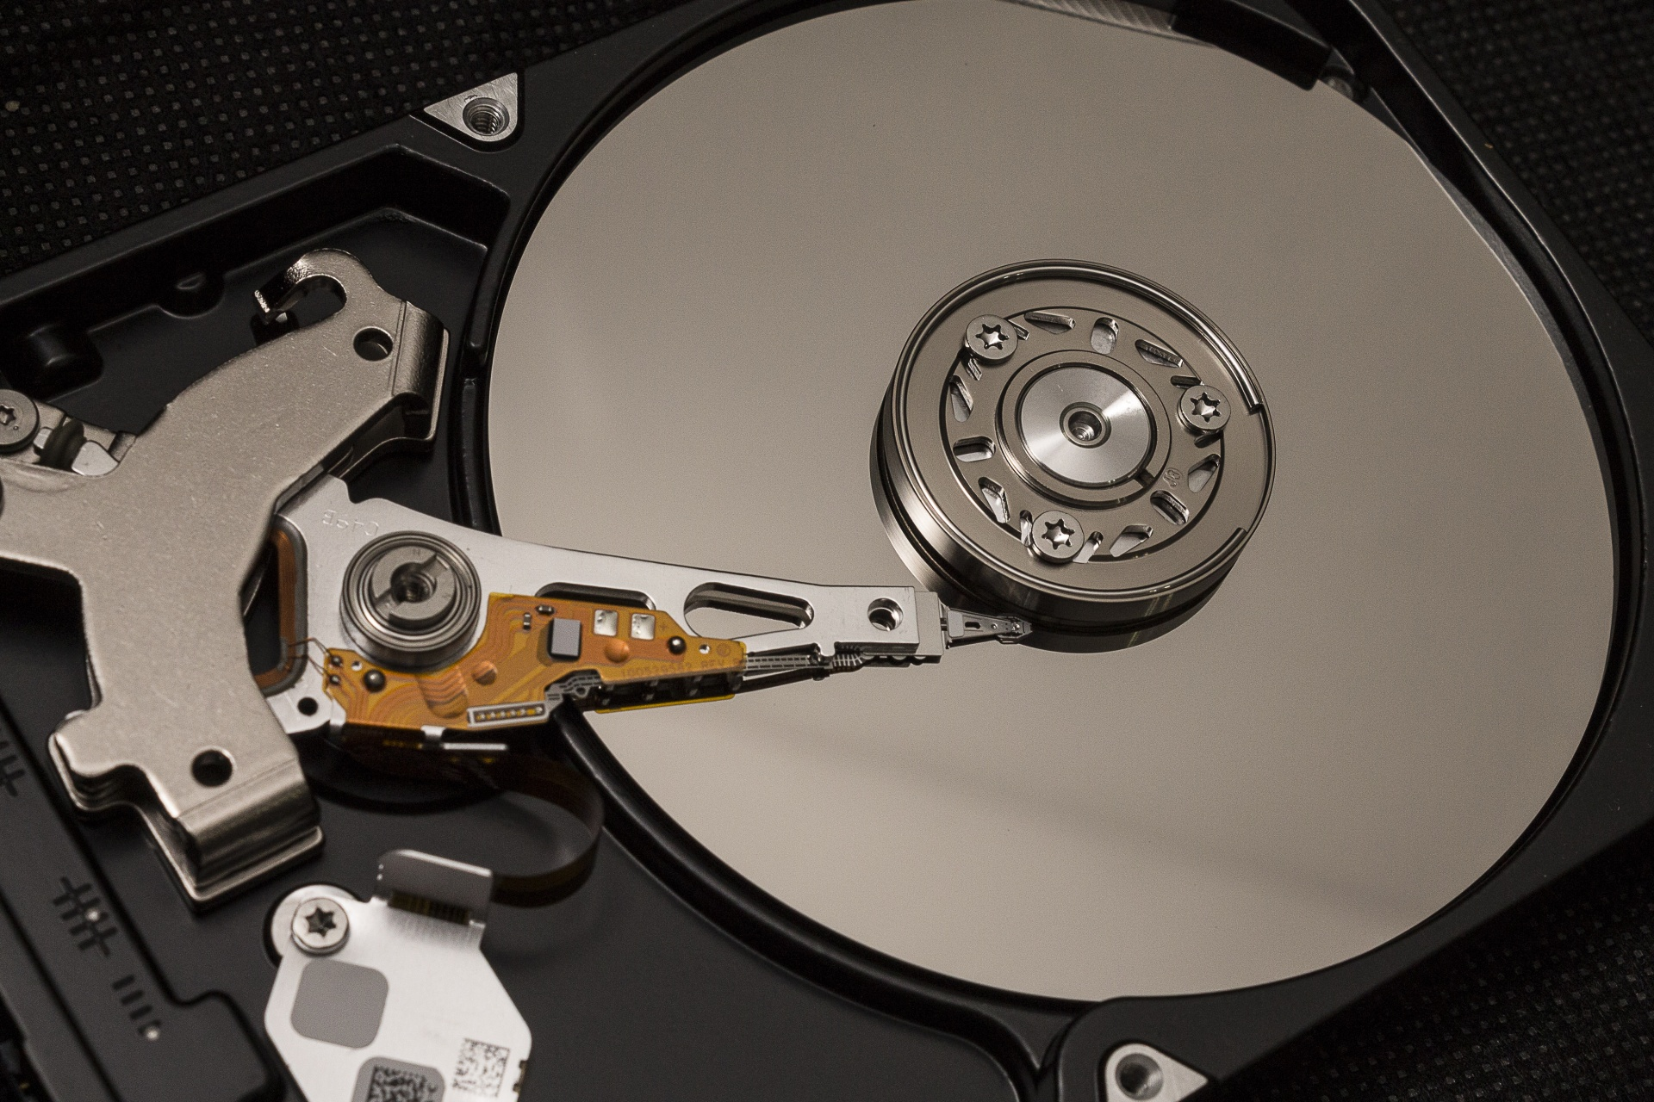
Basic Geometry (Corrected)
Platter (Aluminum coated with a thin magnetic layer)
A circular hard surface
Data is stored persistently by inducing magnetic changes to it
Each platter has 2 sides, each of which is called a surface
Spindle
Spindle is connected to a motor that spins the platters around
The rate of rotations is measured in RPM (Rotations Per Minute)
Typical modern values : 7,200 RPM to 15,000 RPM
E.g., 10000 RPM : A single rotation takes about 6 ms
Track
Concentric circles of sectors
Data is encoded on each surface in a track
A single surface contains many thousands and thousands of tracks
spindle
A Disk with Just A Single Track (12 sectors)

Slide 21
A Simple Disk Drive
Rotates this way
Disk head (one head per surface of the drive)
The process of reading and writing is accomplished by the disk head
Attached to a single disk arm, which moves across the surface
head
spindle
arm
A Single Track Plus A Head

Slide 22
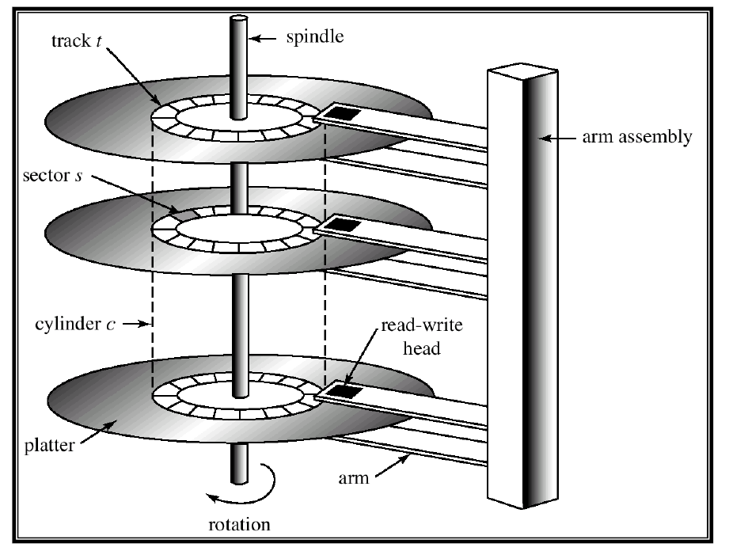
Example of a Disk

Slide 23
Single-track Latency: The Rotational Delay
Rotates this way
Rotational delay: Time for the desired sector to rotate
E.g., full rotational delay is R and we start at sector 6
Read sector 0: Rotational delay = $\frac{R}{2}$ (average case)
Read sector 5: Rotational delay = R (worst case)
head
spindle
arm
A Single Track Plus A Head

Slide 24
Multiple Tracks: Seek Time
Rotates this way
Rotates this way
Remaining rotation
seek
spindle
spindle
E.g., move to sector 11
Seek: move the disk arm to the correct track
One of the costliest disk operations
Seek time: time to move head to the track contain the desired sector

Slide 25
Phases of Seek
Acceleration → Coasting → Deceleration → Settling
Acceleration: The disk arm gets moving
Coasting: The arm is moving at full speed
Deceleration: The arm slows down
Settling: The head is carefully positioned over the correct track
The settling time is often quite significant, e.g., 0.5 to 2ms

Slide 26
Transfer
The final phase of I/O
Data is either read from or written to the surface
Complete I/O time:
Seek
Waiting for the rotational delay
Transfer

Slide 27
Track Skew
Make sure that sequential reads can be properly serviced even when crossing track boundaries
Example:
Moving from 23 to 24
Without track skew, the head would be moved to the next track, but the desired next block would have already rotated under the head
Rotates this way
9
8
19
10
18
20
7
28
29
30
11
17
21
27
31
Spindle
6
16
26
32
22
0
25
33
5
15
24
34
23
35
1
14
12
4
13
2
3
Three Tracks: Track Skew Of 2
Notes:
Example is moving from 23 to 24.

Slide 28
Cache (Track Buffer)
Disk cache holds data read from or written to the disk
Allow the drive to quickly respond to requests
Small amount of memory (usually around 8 or 16 MB)
Write back (Immediate reporting)
Acknowledge a write has completed when it has put the data in its memory
Faster but dangerous
Write through
Acknowledge a write has completed only after the write has been written to disk
Slower but safer

Slide 29
I/O Time: Fun With Math
$$T_{I/O}=T_{seek}+T_{rotation}+T_{transfer}$$
I/O time ($T_{I/O}$):
The rate of I/O ($R_{I/O}$):
$$R_{I/O}=\frac{{Size}_{Transfer}}{T_{I/O}}$$
 | Cheetah 15K.5 | Barracuda
Capacity | 300 GB | 1 TB
RPM | 15,000 | 7,200
Average Seek | 4 ms | 9 ms
Max Transfer | 125 MB/s | 105 MB/s
Platters | 4 | 4
Cache | 16 MB | 16/32 MB
Connects Via | SCSI | SATA
Disk Drive Specs: SCSI Versus SATA

Slide 30
I/O Time Example
Random workload: Issue 4KB read to random locations on the disk
Sequential workload: Read 100MB consecutively from the disk
 |  | Cheetah 15K.5 | Barracuda
$$T_{seek}$$ |  | 4ms | 9 ms
$$T_{rotation}$$ |  | 2 ms | 4.2 ms
Random | $$T_{transfer}$$ | 30 microsecs | 38 microsecs
 | $$T_{I/O}$$ | 6ms | 13.2 ms
 | $$R_{I/O}$$ | 0.66 MB/s | 0.31 MB/s
Sequential | $$T_{transfer}$$ | 800 ms | 950 ms
 | $$T_{I/O}$$ | 806 ms | 963.2ms
 | $$R_{I/O}$$ | 125 MB/s | 105 MB/s
Disk Drive Performance: SCSI Versus SATA
There is a huge gap in drive performance
between random and sequential workloads

Slide 31
Disk Scheduling
Disk Scheduler decides which I/O request to schedule next
SSTF (Shortest Seek Time First)
Order the queue of I/O request by track
Pick requests on the nearest track to complete first
Rotates this way
9
8
21
10
20
22
7
32
33
34
11
19
23
SSTF: Scheduling Request 21 and 2
Issue the request to 21 → issue the request to 2
31
35
Spindle
6
18
30
24
12
0
29
25
5
17
28
26
13
27
1
16
14
4
15
2
3

Slide 32
SSTF is not a panacea
Problem 1: The drive geometry is not available to the host OS
Solution: OS can simply implement Nearest-block-first (NBF)
Problem 2: Starvation
If there were a steady stream of request to the inner track, request to other tracks would then be ignored completely

Slide 33
Elevator (a.k.a. SCAN or C-SCAN)
Move across the disk servicing requests in order across the tracks
Sweep: A single pass across the disk
If a request comes for a block on a track that has already been serviced on this sweep of the disk, it is queued until the next sweep
F-SCAN
Freeze the queue to be serviced when it is doing a sweep
Avoid starvation of far-away requests by nearer by late coming requests
C-SCAN (Circular SCAN)
Sweep from outer-to-inner, and then inner-to-outer, etc.

Slide 34
How to account for Disk rotation costs?
Rotates this way
If rotation is faster than seek : request 16 → request 8
If seek is faster than rotation : request 8 → request 16
9
8
21
10
20
22
7
32
33
34
11
19
23
31
35
Spindle
6
18
30
24
12
0
29
25
5
17
28
26
13
27
1
16
14
4
15
2
3
SSTF: Sometimes Not Good Enough
On modern drives, both seek and rotation are roughly equivalent:
Thus, SPTF (Shortest Positioning Time First) is useful

Slide 35
Where is disk scheduling performed?
Older systems:
OS did all the scheduling
Newer systems:
Disks can handle multiple outstanding requests
Disks have sophisticated internal schedulers
Exact head position is available
Can implement SPTF accurately
OS issues a small number of disk requests (e.g., 16) and issues them all at once
Disk calculates the best possible SPTF order

Slide 36
Other scheduling issues
I/O Merging
Reduce the number of request sent to the disk and lowers overhead
E.g., read blocks 33, then 8, then 34:
The scheduler merge the request for blocks 33 and 34 into a single two-block request
How long to wait before issuing an I/O request?
Work-conserving – Issue I/O request right away
Disk will never be ide if there are requests to serve
Non-work-conserving – wait a little bit before issuing I/O request
A new and better request might arrive at the disk, increasing efficiency

Slide 37
Simplified IDE Driver
// Wait until the drive is ready
static int ide_wait_ready() {
while (((int r = inb(0x1f7)) & IDE_BSY) || !(r & IDE_DRDY))
; // loop until drive isn’t busy
}
// Start an IDE request
static void ide_start_request(struct buf *b) {
ide_wait_ready();
outb(0x3f6, 0); // generate interrupt
outb(0x1f2, 1); // how many sectors?
outb(0x1f3, b->sector & 0xff); // LBA goes here ...
outb(0x1f4, (b->sector >> 8) & 0xff); // ... and here
outb(0x1f5, (b->sector >> 16) & 0xff); // ... and here!
outb(0x1f6, 0xe0 | ((b->dev&1)<<4) | ((b->sector>>24)&0x0f));
if(b->flags & B_DIRTY){
outb(0x1f7, IDE_CMD_WRITE); // this is a WRITE
outsl(0x1f0, b->data, 512/4); // transfer data too!
} else {
outb(0x1f7, IDE_CMD_READ); // this is a READ (no data)
}
}

Slide 38
IDE Read/Write
// IDE read/write
void ide_rw(struct buf *b) {
acquire(&ide_lock);
for (struct buf **pp = &ide_queue; *pp; pp=&(*pp)->qnext)
; // walk queue
*pp = b; // add request to end
if (ide_queue == b) // if q is empty
ide_start_request(b); // send req to disk
while ((b->flags & (B_VALID|B_DIRTY)) != B_VALID)
sleep(b, &ide_lock); // wait for completion
release(&ide_lock);
}

Slide 39
IDE Interrupt
void ide_intr() {
struct buf *b;
acquire(&ide_lock);
if (!(b->flags & B_DIRTY) && ide_wait_ready() >= 0)
insl(0x1f0, b->data, 512/4); // if READ: get data
b->flags |= B_VALID; // buffer has been read from disk
b->flags &= ˜B_DIRTY; // clear dirty bit
wakeup(b); // wake waiting process
if ((ide_queue = b->qnext) != 0) // start next request
ide_start_request(ide_queue); // (if one exists)
release(&ide_lock);
}

